Slide 1
Generative AI
with Large Language Models (LLMs)
Organized by
Department of Mathematics, CEG, Anna University

Slide 2
Outcome of the Workshop
Gain Foundational Knowledge of how Generative AI works
Describe Transformer Architecture and how LLMs are trained and fine-tuned
Describe Retrieval Augmentation Generation and compare it with Fine Tuning
Understand key stages in a typical LLM-based generative AI project lifecycle
Recent Developments in Generative AI / LLM space

Slide 3
Topics Covered
Introduction to Generative AI
Warm-up Test
Tech Foundations of Generative AI
Foundation Models
Self-Supervised Learning
Fine-tuning Foundation Models
Retrieval Augmentation Generation
Fine-Tuning vs Retrieval Augmentation Generation
Lifecycle of a Generative AI project
Exit Test

Slide 4
Vikram Pratap Singh | Founder, Zestifai Technologies
@Zestifai Tech: Building Conversational AI Powered Virtual Assistants for eCommerce and Consulting businesses through their GenAI adoption journey
@VFS Global: Established “Product Innovation & Business Transformation” Dept. Envisioned, designed and led the development of a “Global Digital Platform” for Visa Processing.
@STG International: Established “Center of Excellence” and led the design and development of eLearning and Learning Center Management Systems.
Key Skills: Generative AI, DeepLearning, Machine Learning, Software Architecture, Product Management
Qualification: Master's in Computer Science and PMP, CBIP, TOGAF Certifications among others
Linkedin: https://www.linkedin.com/in/vikrampsingh/ | Website: https://www.zestifai.com

Slide 5
Hands On / Follow Along Exercises
Lab
Prompt Engineering
Fine Tuning
Retrieval Augmentation Generation
Logistics
Hugging Face
PyTorch
Jupyter Notebook

Slide 6
References
The workshop slides, quizzes and exercises heavily depended on following resources. Due credit to respective authors and publishers. These resources are also recommended to workshop participants for further study.
Generative AI with LLMs Course by AWS and DeepLearning.AI: https://www.deeplearning.ai/courses/generative-ai-with-llms/
Transformer and BERT Model Course by Google and DeepLearning.AI: https://www.coursera.org/learn/transformer-models-and-bert-modelb
Fine tuning Large Language Models by Lamini and DeepLearning.AI: https://www.coursera.org/projects/finetuning-large-language-models-project
Serrano Academy Youtube Channel: https://www.youtube.com/@SerranoAcademy
Paper: Attention is all you need: https://arxiv.org/abs/1706.03762
Paper: Low-Rank Adaptation of LLMs - https://arxiv.org/abs/2106.09685
Paper: The Era of 1-bit LLMs - https://arxiv.org/abs/2402.17764

Slide 7
Warm-up Test

Slide 8
Question 1: What is Generative AI?
Generative AI is a type of artificial intelligence (AI) that can create new content, such as discrete numbers, classes, and probabilities. It does this by learning from existing data and then using that knowledge to generate new and unique outputs.
Generative AI is a type of artificial intelligence (AI) that can only create new content, such as text, images, audio, and video by learning from new data and then using that knowledge to predict a discrete, supervised learning output.
Generative AI is a type of artificial intelligence (AI) that can only create new content, such as text, images, audio, and video by learning from new data and then using that knowledge to predict a classification output.
Generative AI is a type of artificial intelligence (AI) that can create new content, such as text, images, audio, and video. It does this by learning from existing data and then using that knowledge to generate new and unique outputs.
Refer: Generative AI with LLMs Course by DeepLearning.AI: https://www.deeplearning.ai/courses/generative-ai-with-llms/
Notes:
Answer: D
Generative AI is a type of artificial intelligence (AI) that can create new content, such as text, images, audio, and video. It does this by learning from existing data and then using that knowledge to generate new and unique outputs.

Slide 9
Question 2: What is an example of both a generative AI model and a discriminative AI model?
A generative AI model could be trained on a dataset of images of cats and then used to generate new images of cats. A discriminative AI model could be trained on a dataset of images of cats and dogs and then used to classify new images as either cats or dogs.
A generative AI model could be trained on a dataset of images of cats and then used to classify new images of cats. A discriminative AI model could be trained on a dataset of images of cats and dogs and then used to predict new images as either cats or dogs.
A generative AI model does not need to be trained on a dataset of images of cats and then used to generate new images of cats, because the images were already generated by using AI. A discriminative AI model could be trained on a dataset of images of cats and dogs and then used to classify new images as either cats or dogs.
A generative AI model could be trained on a dataset of images of cats and then used to cluster images of cats. A discriminative AI model could be trained on a dataset of images of cats and dogs and then used to predict as either cats or dogs.
Refer: Generative AI with LLMs Course by DeepLearning.AI: https://www.deeplearning.ai/courses/generative-ai-with-llms/
Notes:
Answer: A
A generative AI model could be trained on a dataset of images of cats and then used to generate new images of cats. A discriminative AI model could be trained on a dataset of images of cats and dogs and then used to classify new images as either cats or dogs.

Slide 10
Question 3: What are foundation models in Generative AI?
A foundation model is a small AI model pretrained on a small quantity of data that was "designed to be adapted” (or fine-tuned) to a wide range of downstream tasks, such as sentiment analysis, image captioning, and object recognition.
A foundation model is a large AI model both post and pre-trained on a vast quantity of data that was "designed to be adapted” (or fine-tuned) to a wide range of downstream tasks, such as sentiment analysis, image captioning, and object recognition.
A foundation model is a large AI model post-trained on a vast quantity of data that was "designed to be adapted” (or fine-tuned) to a wide range of downstream tasks, such as sentiment analysis, image captioning, and object recognition.
A foundation model is a large AI model pretrained on a vast quantity of data that was "designed to be adapted” (or fine-tuned) to a wide range of upstream tasks, such as sentiment analysis, image captioning, and object recognition.
A foundation model is a large AI model pretrained on a vast quantity of data that was "designed to be adapted” (or fine-tuned) to a wide range of downstream tasks, such as sentiment analysis, image captioning, and object recognition.
Refer: Generative AI with LLMs Course by DeepLearning.AI: https://www.deeplearning.ai/courses/generative-ai-with-llms/
Notes:
Answer: E
A foundation model is a large AI model pre-trained on a vast quantity of data that is "designed to be adapted” (or fine-tuned) to a wide range of downstream tasks, such as sentiment analysis, image captioning, and object recognition.

Slide 11
Question 4: Hallucinations are words or phrases that are generated by the model that are often nonsensical or grammatically incorrect. What are some factors that can cause hallucinations? Select three options.
The model is trained on noisy or dirty data.
The model is not given enough context.
The model is trained on too much data.
The model is not trained on enough data
Refer: Generative AI with LLMs Course by DeepLearning.AI: https://www.deeplearning.ai/courses/generative-ai-with-llms/
Notes:
Answer: A, B, D

Slide 12
Question 5: What is a prompt?
A prompt is a short piece of code that is given to the large language model as input, and it can be used to control the output of the model in many ways.
A prompt is a long piece of text that is given to the large language model as input, and it cannot be used to control the output of the model.
A prompt is a short piece of text that is given to the large language model as input, and it can be used to control the output of the model in many ways.
A prompt is a short piece of text that is given to the large language model as input, and it can be used to control the input of the model in many ways.
A prompt is a short piece of text that is given to the small language model (SLM) as input, and it can be used to control the output of the model in many ways.
Refer: Generative AI with LLMs Course by DeepLearning.AI: https://www.deeplearning.ai/courses/generative-ai-with-llms/
Notes:
Answer: C

Slide 13
Warm Up Quiz Answers
Q1:
Answer: Answer: D
Generative AI is a type of artificial intelligence (AI) that can create new content, such as text, images, audio, and video. It does this by learning from existing data and then using that knowledge to generate new and unique outputs.
Q2:
Answer: A
A generative AI model could be trained on a dataset of images of cats and then used to generate new images of cats. A discriminative AI model could be trained on a dataset of images of cats and dogs and then used to classify new images as either cats or dogs.
Q3:
Answer: E
A foundation model is a large AI model pre-trained on a vast quantity of data that is "designed to be adapted” (or fine-tuned) to a wide range of downstream tasks, such as sentiment analysis, image captioning, and object recognition.
Q4:
Answer: A, B, D
Q5:
Answer: C
Notes:
Answer: C

Slide 14
Introduction to Generative AI
Generative AI
Refers to any AI system whose primary function is to generate content.
This is in contrast to AI systems that perform other functions, such as
Classifying data (e.g., assigning labels to images)
Grouping data (e.g., identifying customer segments with similar behavior)
Predicting (e.g. predicting Housing or Stock Price)
Examples
Image generators (such as Midjourney or Stable Diffusion)
Large language models (such as GPT-4, PaLM, or Claude)
Code generation tools (such as Copilot, AWS Whisperer, Devin)
Video Generation (such as Sora from OpenAI)

Slide 15
Introduction to Generative AI
Large language Models (LLMs)
Refers to the type AI Systems that works with language.
The “large” term refers language models with large number parameters. Research has found that using more data and computational power to train models with more parameters consistently results in better performance.
Examples
Large language models (such as GPT-4, PaLM, or Claude)
Nevertheless, it is still a somewhat vague descriptor. Does a model trained on programming code count as LLms? How about those LLMs that take images as inputs

Slide 16
Introduction to Generative AI
Foundation Models (FMs)
Refers to the type AI Systems with broad capabilities that can be adapted to a range of different, more specific purposes.
The original model provides a base (hence “foundation”) on which other things can be built.
Examples of foundation models include many of the same systems listed as LLMs
At present, “foundation model” is often used interchangeably with “large language model” because language models are currently the clearest example of systems with broad capabilities that can be adapted for specific purposes. E.g. GPT 3.5 served as the foundation for ChatGPT

Slide 17
2. Tech Foundations of Generative AI
Transformer Architecture
Self-Attention Mechanism
Parallel Processing
Pre-Training
Tokenization
Self-Supervised Learning
Prompt Engineering
Zero Shot
One Shot
Few Shot
Fine-Tuning
Full Fine tuning (Instruction Fine Tuning)
Partial Fine Tuning (PEFT: LoRA, QLoRA)
Retrieval Augmentation Generation

Slide 18
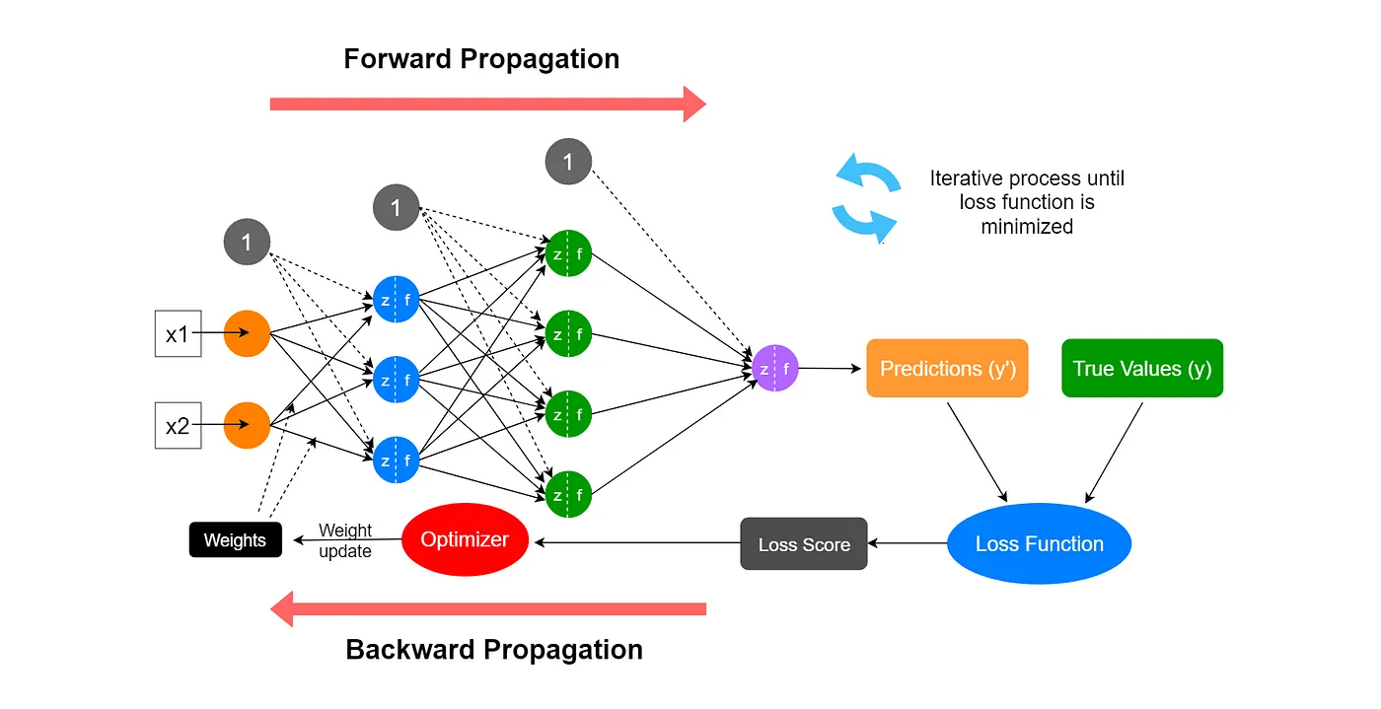
2. Tech Foundations of Generative AI: Weights and Biases
Neural networks
Has Weights and Biases, and during training, its goal is to adjust those weights to reduce a Loss Function. Typically represented as matrices for each layer
During the training process, these parameters are adjusted iteratively to minimize the difference between the predicted output and the actual output, thereby improving the model's performance
Employs Backpropagation algorithm to adjust the weights of the connections in the network in order to minimize the error between the predicted output and the actual output of the network.
Images: https://medium.com/data-science-365/overview-of-a-neural-networks-learning-process-61690a502fa
Notes:
Weights in a neural network are numerical values that represent the strength of connections between neurons in adjacent layers. These weights are typically represented as matrices for each layer, where each element in the matrix corresponds to the weight of a connection between a neuron in the current layer and a neuron in the next layer.
Let's consider a simple example of a fully connected neural network with one input layer, one hidden layer, and one output layer. If we denote the number of neurons in the input layer as input​, the number of neurons in the hidden layer as hidden, and the number of neurons in the output layer as output​, then the weights between the input layer and the hidden layer can be represented by a matrix W[1], and the weights between the hidden layer and the output layer can be represented by a matrix W[2].
The dimensions of these weight matrices depend on the architecture of the neural network. For example, if the input layer has 3 neurons, the hidden layer has 4 neurons, and the output layer has 2 neurons, then:
W[1]will be a 4×3 matrix, where each element represents the weight of a connection between a neuron in the input layer and a neuron in the hidden layer.
W[2] will be a 2×4 matrix, where each element represents the weight of a connection between a neuron in the hidden layer and a neuron in the output layer.
----------

Slide 19
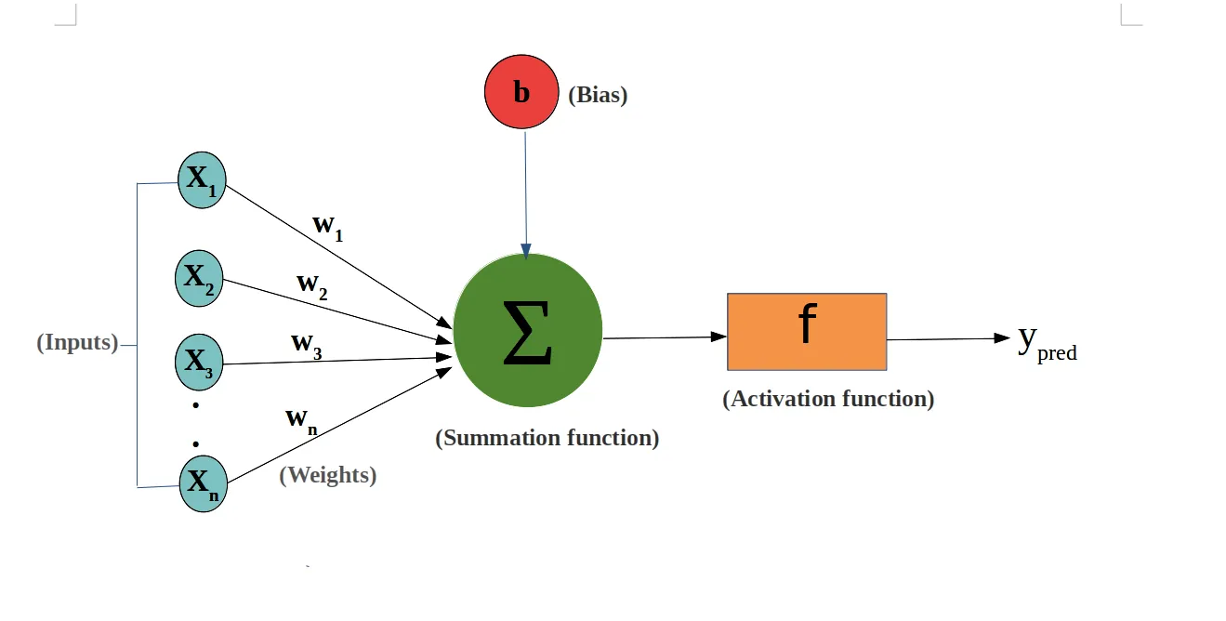
2. Tech Foundations of Generative AI: Weights and Biases
Weights
Fundamental components that enable the network to learn from data during training process.
Represent the strength of connections between neurons in adjacent layers and attached with each input/feature and they convey the importance of that corresponding feature in predicting the final output.
Biases
Additional parameters in neural networks that are added to the weighted sum of inputs to the neurons.
Bias is used for shifting the activation function towards left or right, you can compare this to y-intercept in the line equation. Allow the neural network to learn the best output given a certain input.

Slide 20
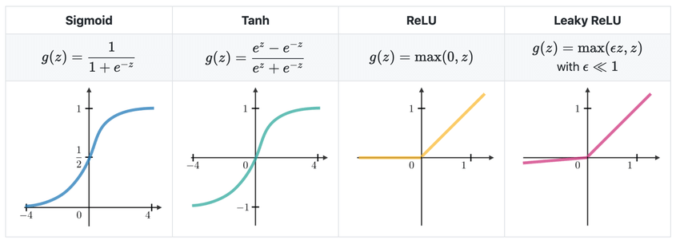
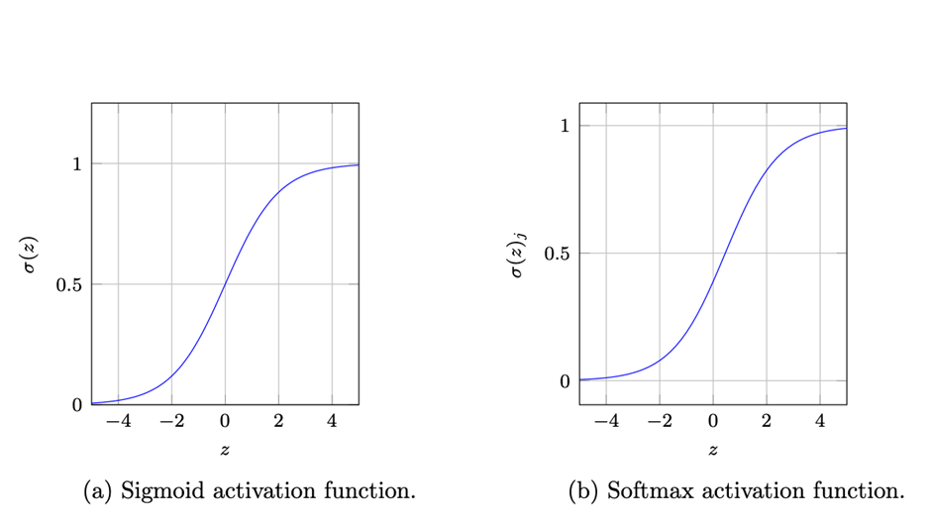
2. Tech Foundations of Generative AI: Activation Functions
Activation Function:
It is used to introduce non-linearity in the model.
It determines whether a neuron should be activated or not based on the input it receives.
Rectified Linear Unit (ReLU): Linear for positive values and zero for negative values, which helps with the vanishing gradient problem and speeds up training.
Sigmoid: S-shaped curve, squashes the input into a range between 0 and 1.
Softmax: Used in the output layer of a neural network for multi-class classification, squashes the inputs into a probability distribution.
Notes:
Sigmoid Activation Function: A Nonlinear Logistic Function
The Sigmoid activation function is a type of logistic activation function primarily utilized in the hidden layers of neural networks. Its purpose is to map the linear output into a nonlinear range. The Sigmoid function is known for its characteristic of restricting the output within a bounded range of 0 and 1.
1 – Binary Classification in the Logistic Regression model: The Sigmoid function is used in logistic regression models to classify data into two different categories.
2 – Hidden Layers of Neural Networks: In various deep learning architectures, the Sigmoid activation function aids in introducing nonlinearity during the information transformation process.
3 - Used for Binary Classification in the Logistic Regression model. The probabilities sum of sigmoid does not need to be 1.
Softmax Activation Function Applications
The Softmax activation function, on the other hand, is primarily used in situations where the output of the neural network is categorical. areas where the Softmax function finds its utility:
1 – Artificial and Convolutional Neural Networks: In neural networks, output normalization is often applied to map non-normalized output to a probability distribution for output classes. Softmax is commonly used in the final layers of neural network-based classifiers, such as in artificial and convolutional neural networks.
2 – Multiclass Classification Methods: The Softmax function is also employed in various multiclass classification techniques, including Multiclass Linear Discriminant
3 – Probability Distribution: Unlike the Sigmoid function, the probabilities obtained from the Softmax function always sum up to 1. Analysis (MLDA) and Naive Bayes Classifiers.

Slide 21
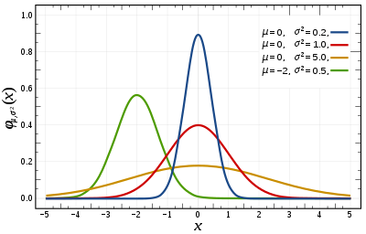
2. Tech Foundations of Generative AI: Weight Initialization
Weights Initialization Technique
Random Initialization, Xavier/Glorot Initialization, He Initialization, Uniform Initialization
Weight Size
Typically represented using floating-point numbers, which can be stored using different precisions. Example: 4-bit, 8-bit, 32-bit (single precision) or 64-bit (double precision).
Weights Values
Random initialization from a normal distribution: with a small standard deviation, such as 0.01 or 0.1.
For example, if we initialize weights from a Normal / Gaussian distribution with mean 0 and standard deviation 0.01:
Approximately 68% of the values will fall within one standard deviation of the mean.
Approximately 95% of the values will fall within two standard deviations of the mean.
Approximately 99.7% of the values will fall within three standard deviations of the mean.
1.58-bit
Notes:
The choice of initialization method can depend on factors such as the architecture of the network, the activation functions used, and the specific problem being addressed. Let's explore some common initialization techniques and the typical range of values for initialized weights:
Random Initialization:
One common approach is to initialize the weights randomly from a uniform or normal distribution.
For example, weights can be randomly sampled from a uniform distribution between -1 and 1 or from a normal distribution with mean 0 and a small standard deviation.
Random initialization helps break the symmetry in the network and prevents neurons from learning the same features.
Xavier/Glorot Initialization:
Xavier initialization is a widely used technique that aims to keep the variance of activations and gradients roughly constant across layers during training.
The weights are initialized by sampling from a distribution with zero mean and a variance that depends on the number of input and output neurons.
For a layer with ninnin​ input neurons and noutnout​ output neurons, the variance of the weights is typically calculated as 2nin+noutnin​+nout​2​.
He Initialization:
He initialization is similar to Xavier initialization but is specifically designed for networks using activation functions like ReLU.
The weights are initialized by sampling from a distribution with zero mean and a variance that depends on the number of input neurons.
For a layer with ninnin​ input neurons, the variance of the weights is typically calculated as 2ninnin​2​.
Uniform Initialization:
Weights can also be initialized uniformly within a specified range.
For example, weights can be initialized uniformly between -0.5 and 0.5 or between -0.1 and 0.1.
The range of values that initialized weights can contain depends on the specific initialization technique and the distribution used for sampling. However, it's important to note that the range of initialized weights should generally be small to avoid saturation of activation functions and gradients. Common ranges for initialized weights include:
Random initialization from a uniform distribution: typically between -1 and 1 or between -0.1 and 0.1.
Random initialization from a normal distribution: with a small standard deviation, such as 0.01 or 0.1.
Xavier/Glorot and He initialization: the range depends on the specific formula used for calculating the variance, but the values are typically small to ensure stable training.
Overall, the choice of weight initialization method and the range of values can have a significant impact on the convergence and performance of the neural network during training. Experimentation and tuning may be necessary to find the most effective initialization strategy for a given problem and network architecture.

Slide 22
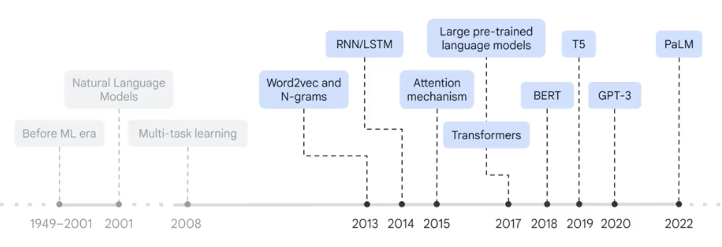
2. Tech Foundations of GenAI: Language Model History
2013: Word2Vec and N-Grams
2014: RNN/LSTM
2015: Attention Mechanism
2017: Transformers → Large Pre-Trained Language Models
2018: BERT
2019: T5
2020: GPT3
2022: PaLM

Slide 23

2. Tech Foundations of GenAI: Word2Vec
Technique in natural language processing (NLP) used to represent words as dense, continuous-valued vectors in a high-dimensional space.
These word embeddings capture semantic and syntactic similarities between words, enabling machines to understand and process natural language more effectively.
Word2Vec word embedding space is a hyperparameter that needs to be specified before training the model and the choice of dimensionality depends on Task-specific Requirements, Size of Vocabulary, Available Computational Resources etc.
Notes:
There are two main architectures for Word2Vec:
Continuous Bag of Words (CBOW): Predicts the target word based on the context words (surrounding words).
Skip-gram: Predicts the context words given the target word.
Both CBOW and Skip-gram architectures use shallow neural networks with a single hidden layer to learn word embeddings.
Continuous Bag of Words (CBOW):
In the CBOW architecture, the model predicts the target word based on the context words (surrounding words).
Given a sequence of words in a context window, the objective is to predict the target word in the center of the window.
The input to the model is the one-hot encoded vectors representing the context words, and the output is a softmax layer predicting the probability distribution over the vocabulary.
The hidden layer between the input and output layers represents the word embeddings.
During training, the model adjusts the word embeddings to maximize the likelihood of predicting the target word given the context.
Skip-gram:
In the Skip-gram architecture, the model predicts the context words given the target word.
Given a target word, the objective is to predict the context words that appear within a certain window around the target word.
The input to the model is the one-hot encoded vector representing the target word, and the output is multiple softmax layers, each predicting the probability distribution over the vocabulary for a specific context word.
Like CBOW, the hidden layer represents the word embeddings, and the model is trained to adjust these embeddings to maximize the likelihood of predicting the context words given the target word.

Slide 24
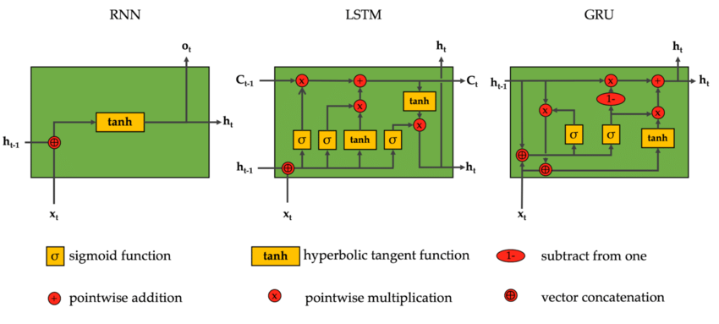
2. Tech Foundations of GenAI: RNN → LSTM → GRU
Recurrent Neural Networks (RNNs) are a class of neural networks specifically designed to handle sequential data, such as time-series data, text, speech, and video.
RNNs have connections that form directed cycles, allowing them to exhibit temporal dynamics and capture dependencies between inputs across time steps.
Traditional RNNs suffer from the vanishing gradient problem, which makes it difficult to capture long-range dependencies in sequences.
Long Short-Term Memory (LSTM) and Gated Recurrent Unit (GRU) are two popular variants of RNNs that address this issue.
Images: https://www.researchgate.net/figure/Computation-wise-comparison-of-RNN-LSTM-and-GRU-nodes_fig4_342316332

Slide 25
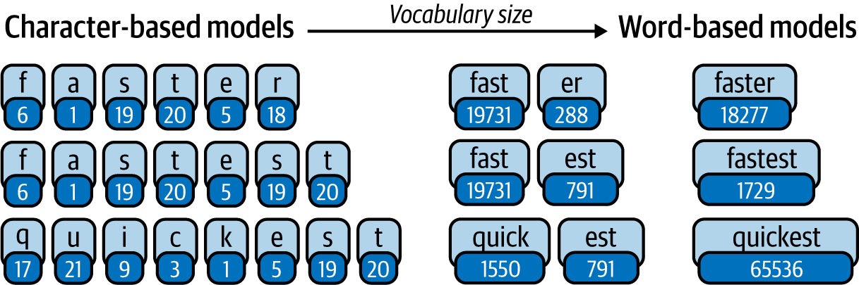
2. Tech Foundations of GenAI: Tokenization
Tokenization is the process of breaking down a sequence of text into smaller units called tokens. It lays the foundation for further analysis and processing.
A fundamental step that breaks down unstructured text into discrete elements/numbers.
With this numeric representation we can train the model to perform various tasks, such as classification, sentiment analysis, or language generation.
These tokens can be words, characters, or even subwords, depending on the chosen tokenization strategy.
Refer: https://www.oreilly.com/library/view/applied-natural-language/9781492062561/ch04.html

Slide 26
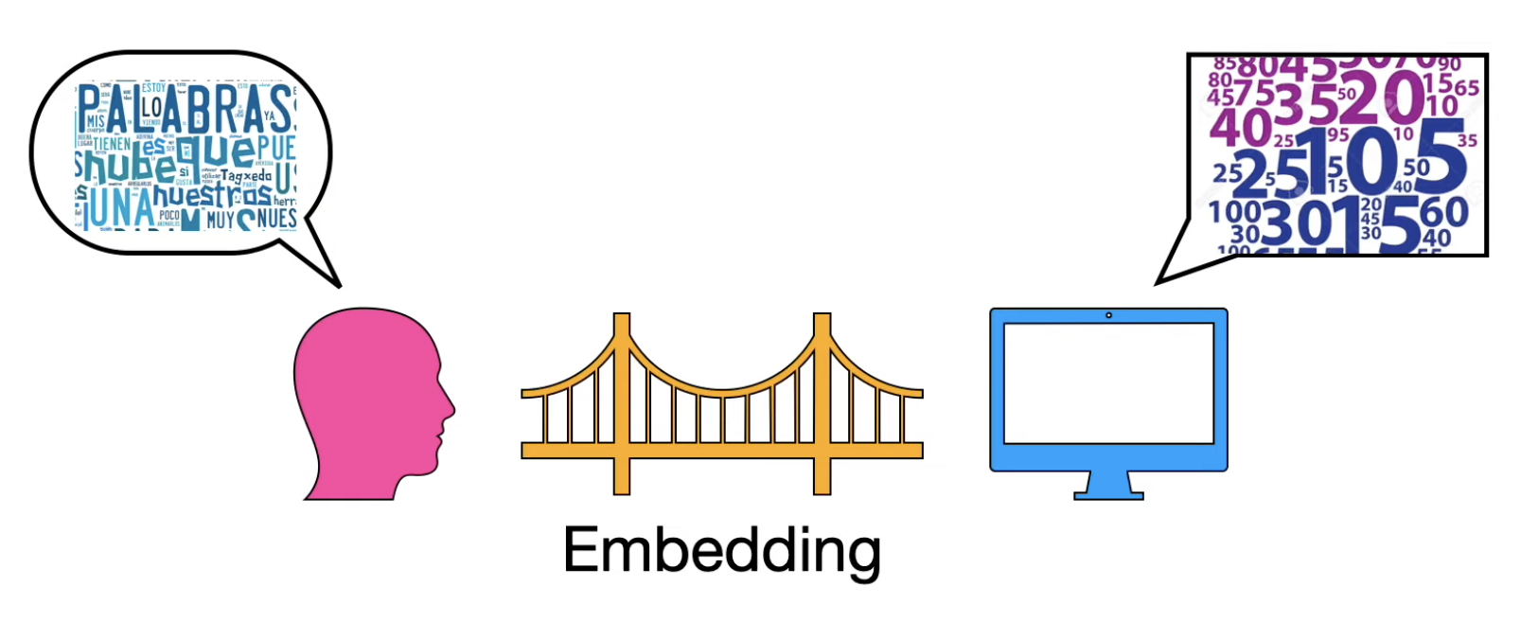
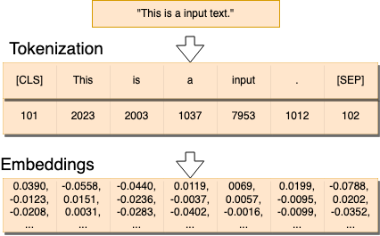
2. Tech Foundations of GenAI: Tokenization
Tokenization is cutting input data into parts that can be mapped (embedded) into a vector space.
Special tokens are appended to the sequence e.g. class token ([CLS]) used for classification embedding in BERT transformer.
Tokens are mapped to vectors which are passed into neural neural networks.
Token sequence position itself is often vectorized and added to the word embeddings (positional encodings).
Images: https://www.youtube.com/watch?v=OxCpWwDCDFQ

Slide 27
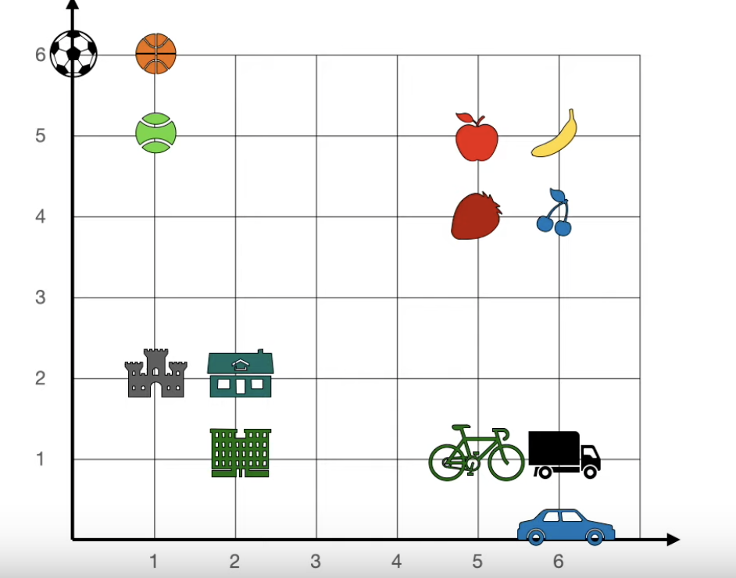
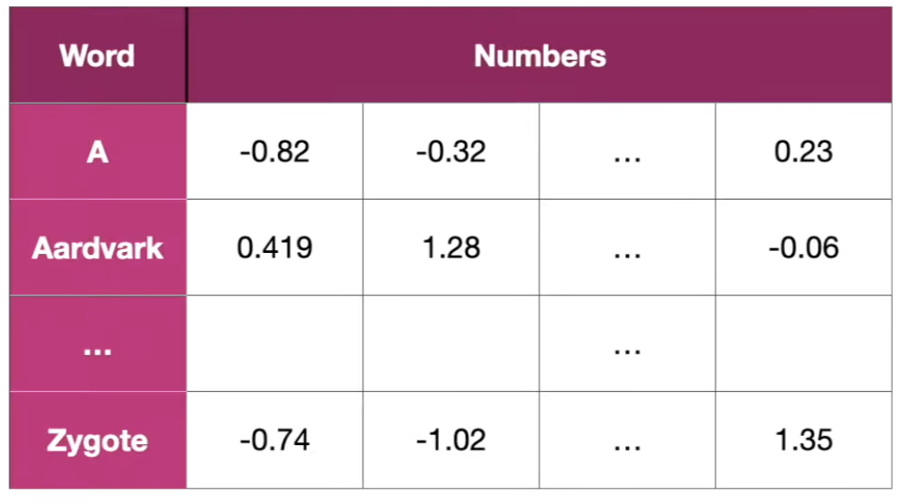
2. Tech Foundations of GenAI: Embeddings
In the context of natural language processing (NLP), embeddings refer to dense, continuous-valued vector representations of words or tokens in a high-dimensional space.
These embeddings capture semantic and syntactic similarities between words, enabling machine learning models to understand and process natural language more effectively.
Word embeddings represented by a vector of real numbers, as opposed to one-hot encoding, which represents each word as a sparse binary vector.
Images: https://www.youtube.com/watch?v=qaWMOYf4ri8&t=2333s

Slide 28
2. Tech Foundations of GenAI: Positional Encoding
Positional encoding is a technique used in transformer-based architectures to addresses the lack of sequential order information in the transformer model by providing a way to encode the positional information of tokens within a sequence.
Transformer architecture, the input tokens are processed independently of their positions within the sequence, which can result in the loss of sequential order information.
Positional encoding is introduced to overcome the limitation by adding positional information to the input embeddings before feeding them into the transformer model.
Positional encoding is usually represented as a matrix of the same dimension as the input embeddings. Each row of the matrix corresponds to a position in the sequence, and each column corresponds to a dimension in the embedding space.
The positional encoding matrix is added element-wise to the input embeddings, effectively injecting positional information into the embeddings.
The positional encoding matrix is computed based on a set of sinusoidal functions of different frequencies and phases.

Slide 29
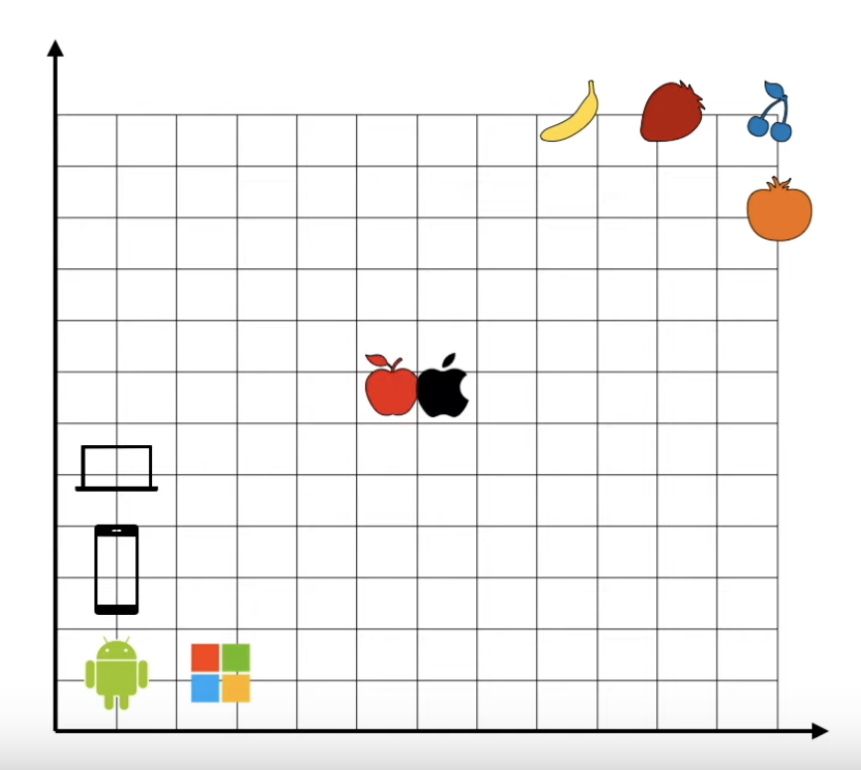
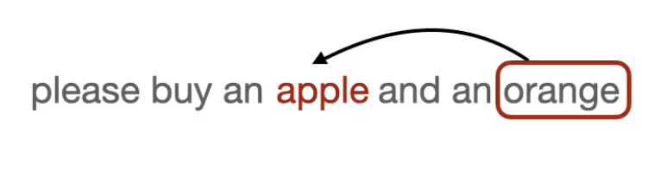
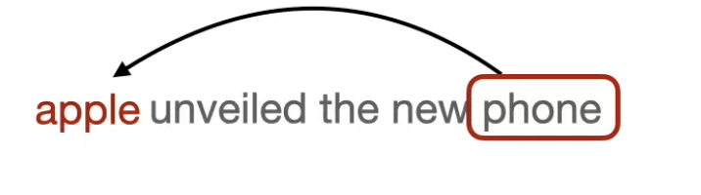
2. Tech Foundations of GenAI: Attention
How to ensure that apple fruit finds it place near top right and apple company finds its place near left bottom - Attention!
Attention uses context to solve such problems
In the first sentence “Please buy an apple and orange”, its orange which suggests that apple is fruit
In the second sentence “Apple unveiled the new phone”, its the phone that suggests that this apple refers to apple company.
Images: https://www.youtube.com/watch?v=OxCpWwDCDFQ

Slide 30
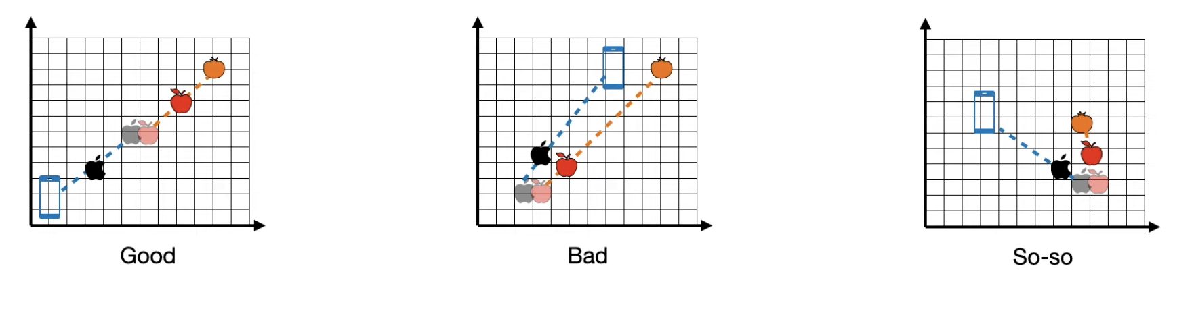
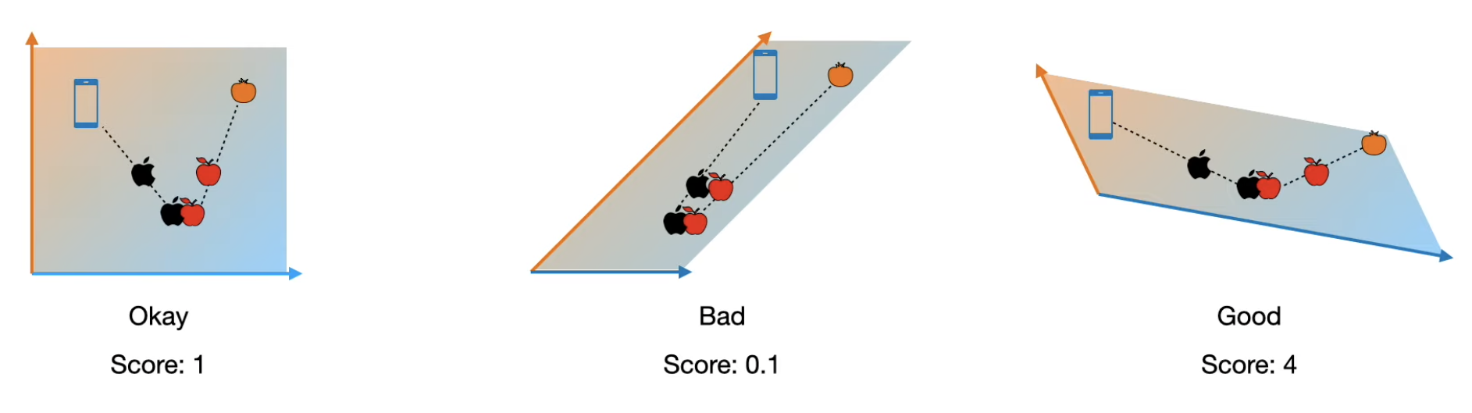
2. Tech Foundations of GenAI: Multi-head Attention
We can have multiple embeddings instead of one and combine them to have better results. That leads to multi-head attention.
We can build embeddings from existing embeddings using linear transformations.
Linear transformations could be achieved through Rotation, Stretch, Sheer and their combinations
Good embeddings get good score and bad gets low score
Images: https://www.youtube.com/watch?v=OxCpWwDCDFQ

Slide 31
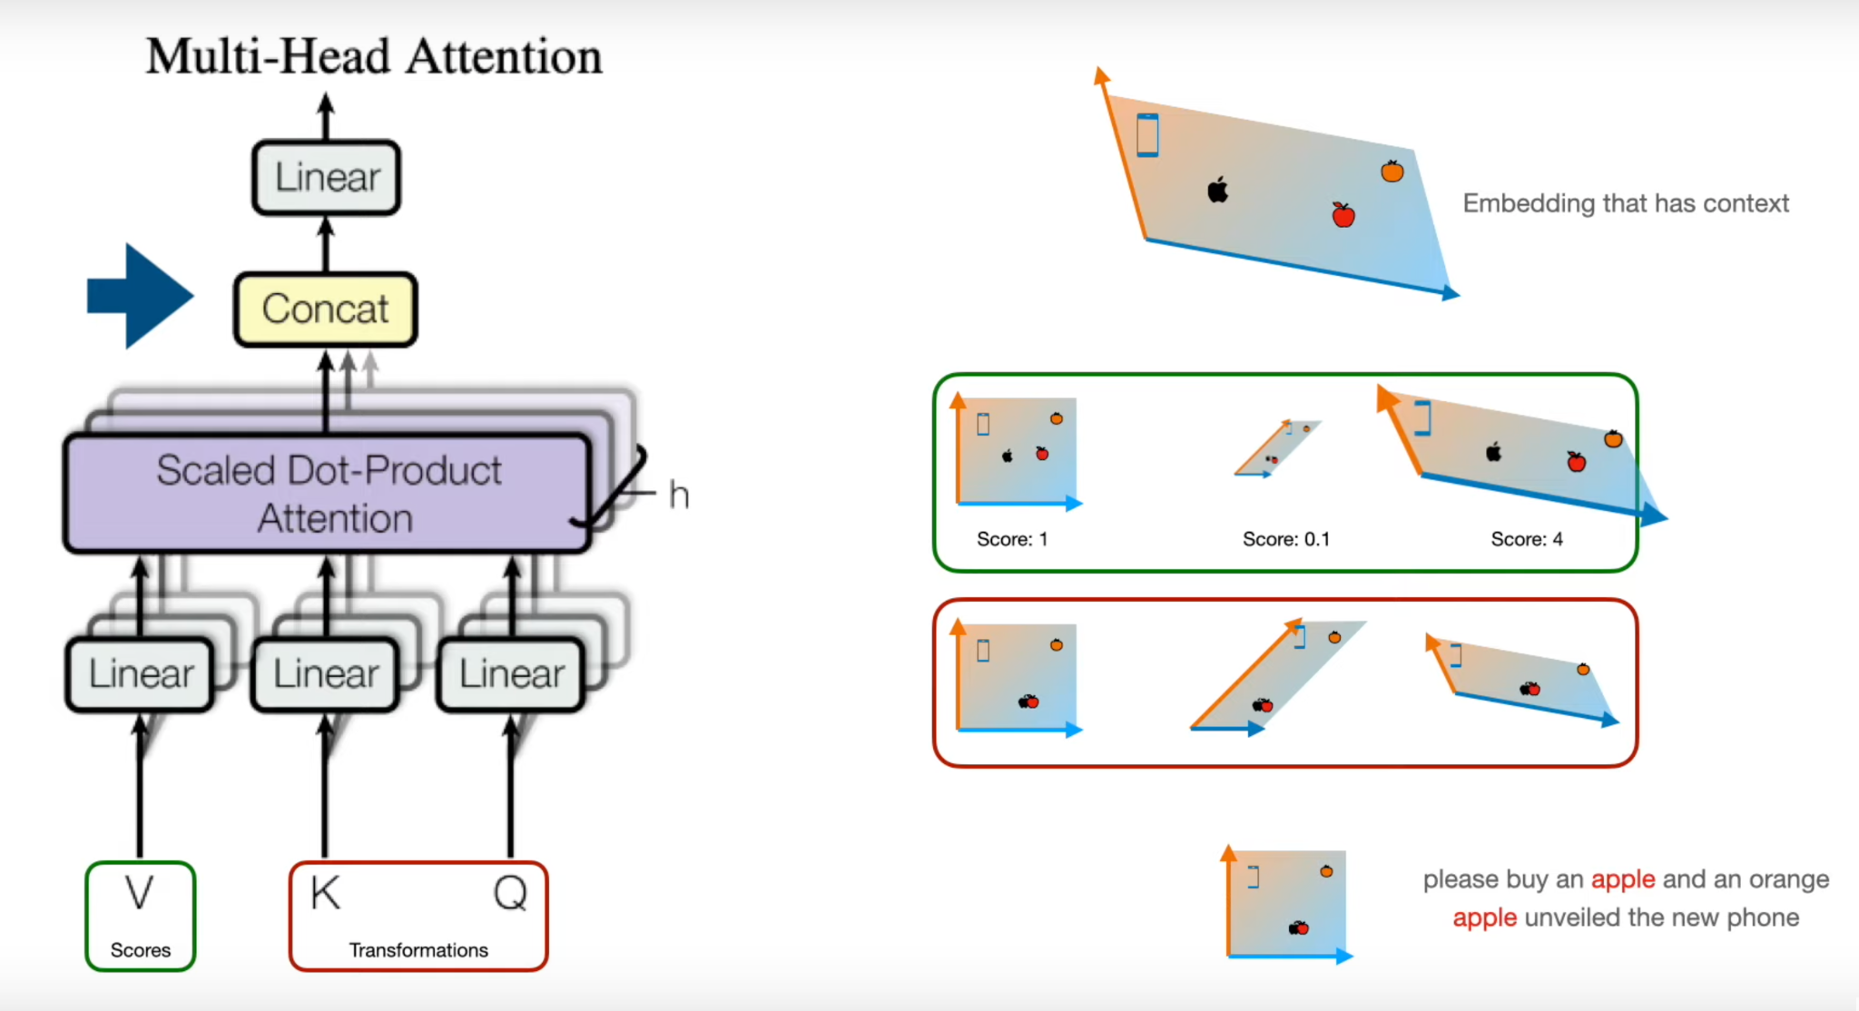
2. Tech Foundations of GenAI: Multi-head Attention
As we train the neural network, we train these embeddings and train their score and that is where Key, Query and Value Matrices comes in.
Images: https://www.youtube.com/watch?v=OxCpWwDCDFQ

Slide 32
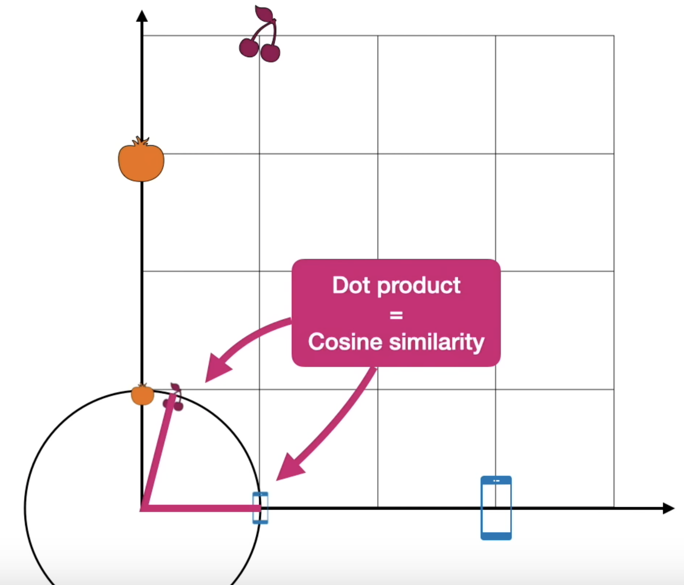
2. Tech Foundations of GenAI: Attention Maths
Similarity Measures
Dot Product
Cosine Similarity
Both are same when we scale down such that all vectors have unit length i.e they are same upto a scalar.
Scaled Dot Product
Divide the dot product by square root of the length of the vector.
To calculate attention, we generally use scaled dot product.
Images: https://www.youtube.com/watch?v=OxCpWwDCDFQ

Slide 33
2. Tech Foundations of GenAI: Attention Mechanism
Steps to compute Attention
Similarity Calculation: The model compares the query with each Key in the encoded input sequence. This can be done using a dot product or a more complex function.
Attention Weights: The similarity scores are normalized to get weights between 0 and 1. These weights indicate how much attention the model should pay to each element in the input sequence.
Context Vector: The model creates a context vector by taking a weighted sum of the Values from the input sequence, using the attention weights as the weights. This context vector summarizes the most relevant information from the input based on the current query.
Decoder Update: The decoder uses the context vector along with other information to generate the next output element (like a word in a translation).
Notes:
These weights can be computed either in parallel (such as in transformers) or sequentially (such as recurrent neural networks).
Attention was developed to address the weaknesses of leveraging information from the hidden outputs of recurrent neural networks. Recurrent neural networks favor more recent information contained in words at the end of a sentence, while information earlier in the sentence is expected to be attenuated. Attention allows the calculation of the hidden representation of a token equal access to any part of a sentence directly, rather than only through the previous hidden state.
N-Grams:
Attention Mechanism:
Transformers:
BERT:
T5:

Slide 34
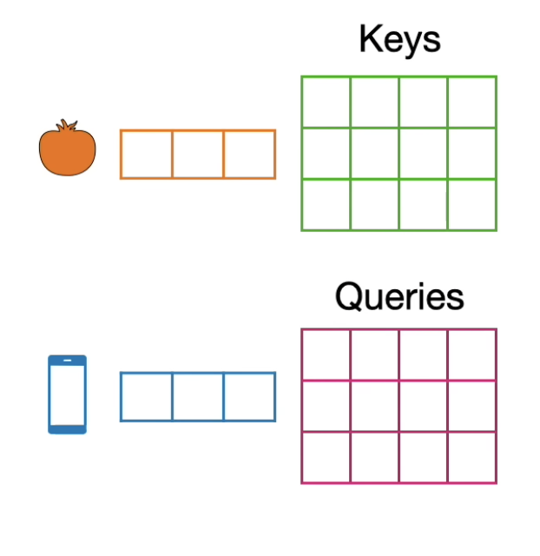
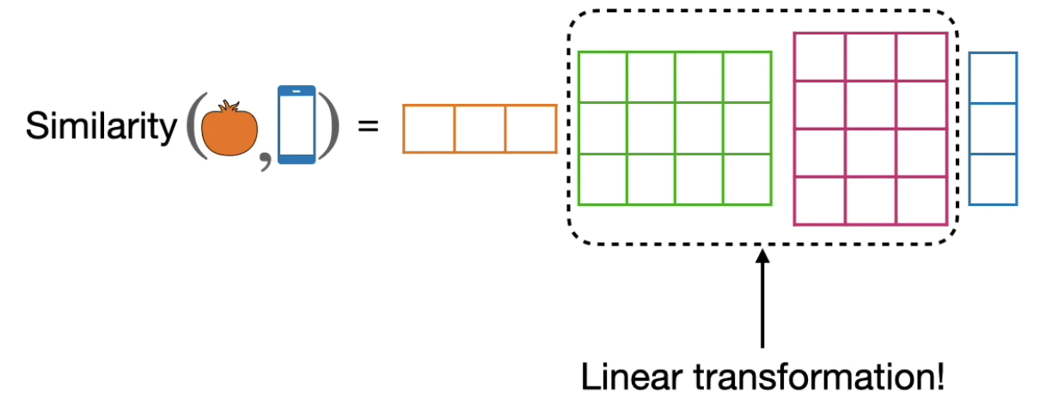
2. Tech Foundations of GenAI: Attention Mechanism
It enables LLMs to focus on different parts of input data with varying degrees of importance, allowing for more effective learning and processing of sequential data such as text or time-series data.
The attention mechanism allows the model to dynamically weigh the importance of each input token based on its relevance to the current context, rather than treating all tokens equally.
Key Components of attention: Keys, Query and Values
Keys and Query Matrix helps us find good embeddings where we can do attention and find really good information and all this is achieved using linear transformation. Keys and Query modify the embeddings.
Images: https://www.youtube.com/watch?v=UPtG_38Oq8o
Notes:
N-Grams:
Attention Mechanism:
Transformers:
BERT:
T5:

Slide 35
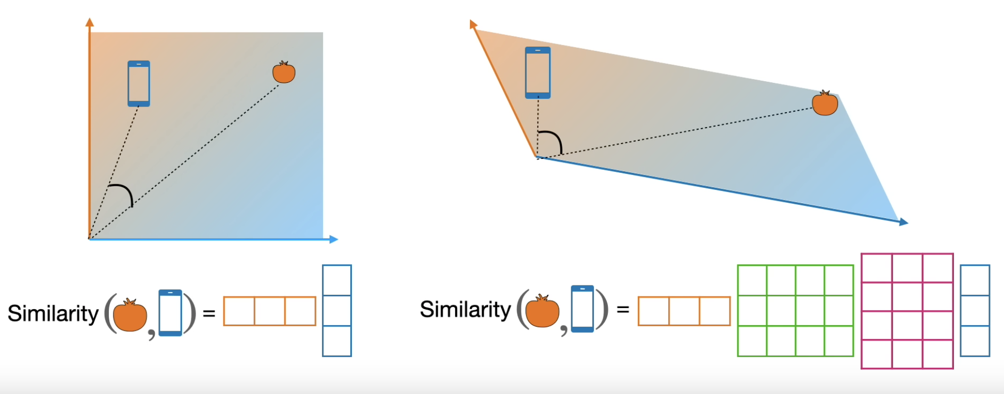
2. Tech Foundations of GenAI: Attention Mechanism
Similarity on a transformed embeddings. Keys and Queries matrix turn the embeddings into one that is best for calculating similarities.
Keys and Queries Matrix turn the embeddings into that is best for calculator similarities.
Images: https://www.youtube.com/watch?v=UPtG_38Oq8o
Notes:
N-Grams:
Attention Mechanism:
Transformers:
BERT:
T5:

Slide 36
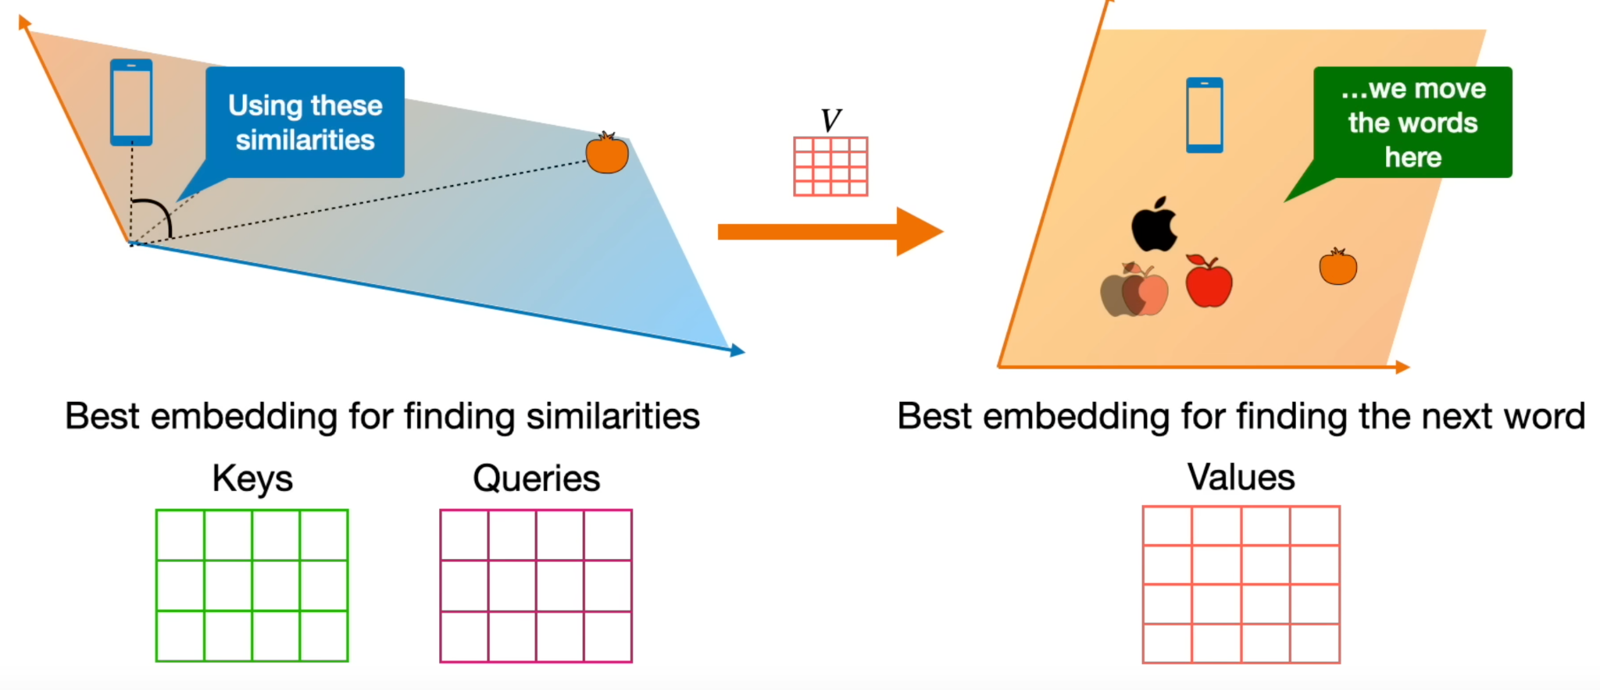
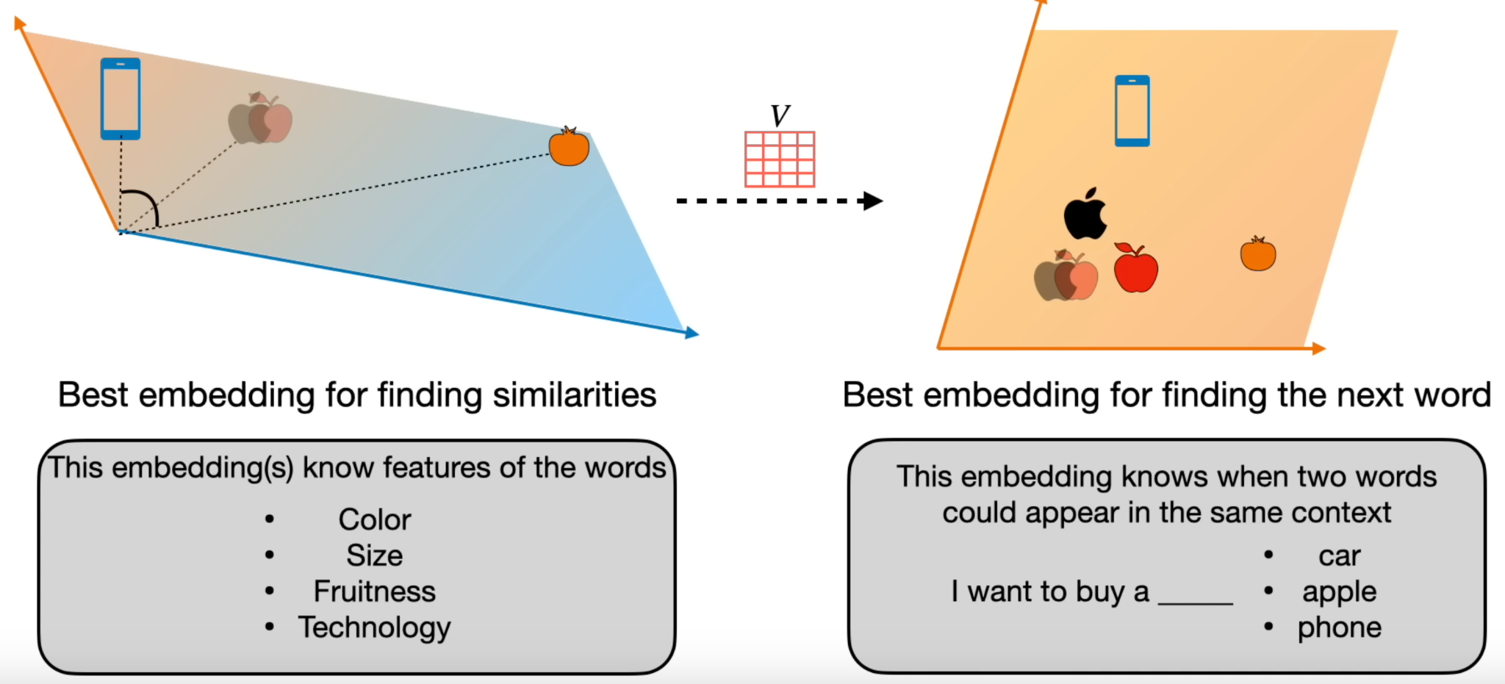
2. Tech Foundations of GenAI: Attention Mechanism
On the left is the best embeddings for finding the similarities and on the right is the best embeddings for finding the next word. Embeddings on the left is found by Keys and Queries Matrices and the embeddings on the right is found by the values.
Note: Transformer is best at finding the next word in the sentence and keeps finding next word until it builds required text.
Keys and Queries matrices capture the granular features of the word embeddings. That how keys and Queries matrix give the best embeddings to apply attention.
The Value matrix takes the embeddings on the left and multiplies every vector to get the embeddings on the right. Multiplication with Value matrix yields another transformation.
Images: https://www.youtube.com/watch?v=UPtG_38Oq8o
Notes:
N-Grams:
Attention Mechanism:
Transformers:
BERT:
T5:

Slide 37
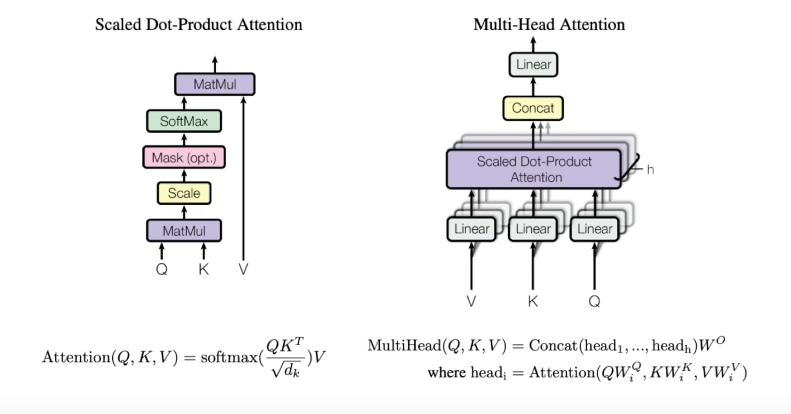
2. Tech Foundations of GenAI: Attention
Images: https://www.youtube.com/watch?v=OxCpWwDCDFQ&t=1s

Slide 38
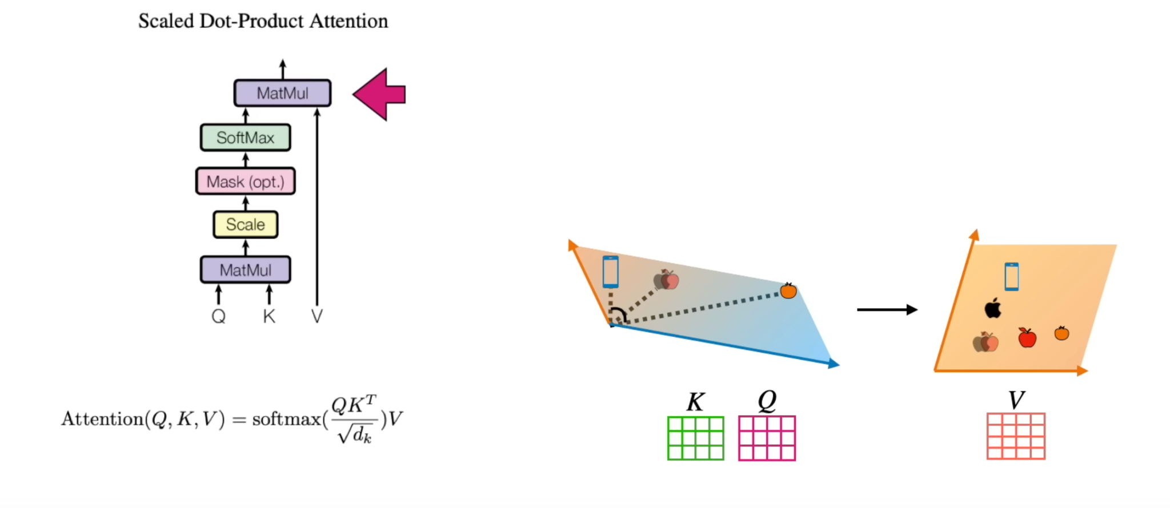
2. Tech Foundations of GenAI: Self Attention
Images: https://www.youtube.com/watch?v=OxCpWwDCDFQ&t=1s
Notes:
These weights can be computed either in parallel (such as in transformers) or sequentially (such as recurrent neural networks).
Attention was developed to address the weaknesses of leveraging information from the hidden outputs of recurrent neural networks. Recurrent neural networks favor more recent information contained in words at the end of a sentence, while information earlier in the sentence is expected to be attenuated. Attention allows the calculation of the hidden representation of a token equal access to any part of a sentence directly, rather than only through the previous hidden state.
N-Grams:
Attention Mechanism:
Transformers:
BERT:
T5:

Slide 39
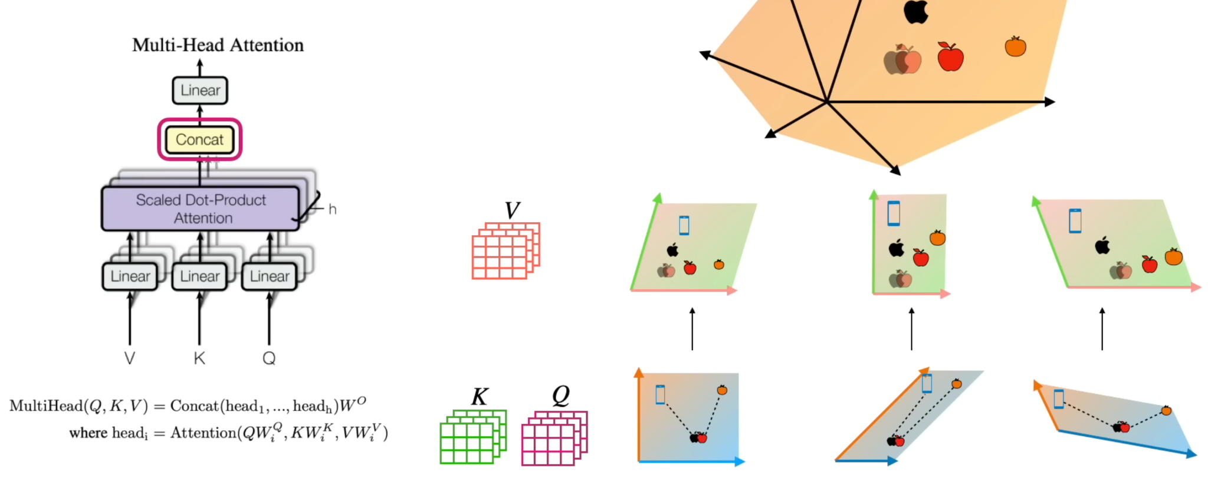
2. Tech Foundations of GenAI: Multi-head Attention
Images: https://www.youtube.com/watch?v=OxCpWwDCDFQ&t=1s
Notes:
Word2Vec:
N-Grams:
Attention Mechanism:
Transformers:
BERT:
T5:

Slide 40
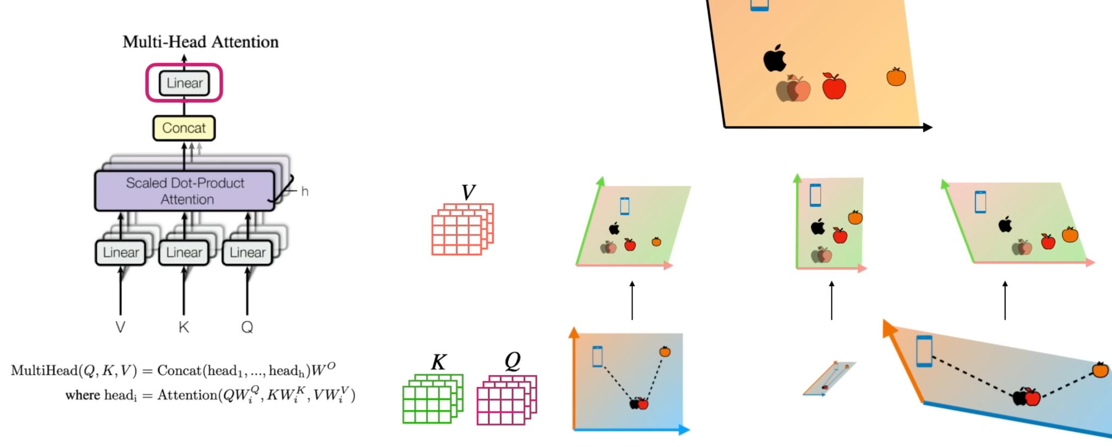
2. Tech Foundations of GenAI: Multi-head Attention
Images: https://www.youtube.com/watch?v=OxCpWwDCDFQ&t=1s

Slide 41
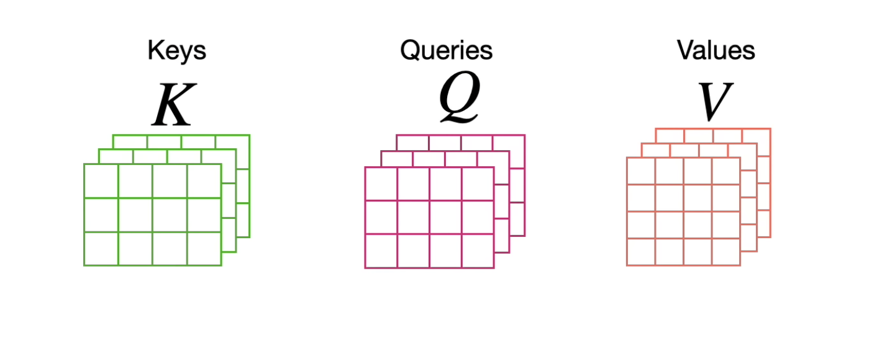
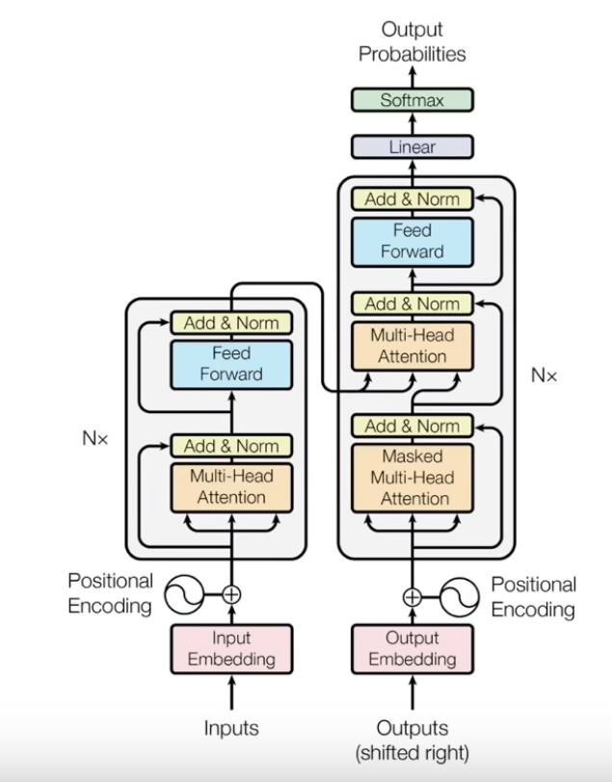
2. Tech Foundations of GenAI: Query, Key and Value Matrices
The K, Q and V matrices are derived from the input embeddings and trained using transformer model
These matrices are used to compute attention scores, which determine the importance of different parts of the input sequence.
The input embeddings or hidden states are linearly projected into three separate sets of vectors: query vectors, key vectors, and value vectors; implemented using learnable weight matrices.
Each set of vectors (queries, keys, and values) has its own weight matrices, which are learned during the training of the model.
Images: https://www.youtube.com/watch?v=OxCpWwDCDFQ&t=1s

Slide 42
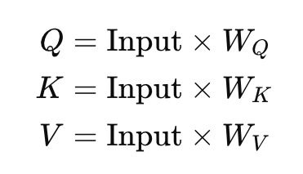
2. Tech Foundations of GenAI: Query, Key and Value Matrices
The query matrix Q, key matrix K, and value matrix V are obtained by multiplying the input embeddings by their respective weight matrices.
Here, Input represents the input embeddings, and W_{Q}​, W_{K}​, and W_{V}​ are the weight matrices for queries, keys, and values, respectively.
The query, key, and value matrices are used to compute attention scores between tokens in the input sequence.

Slide 43
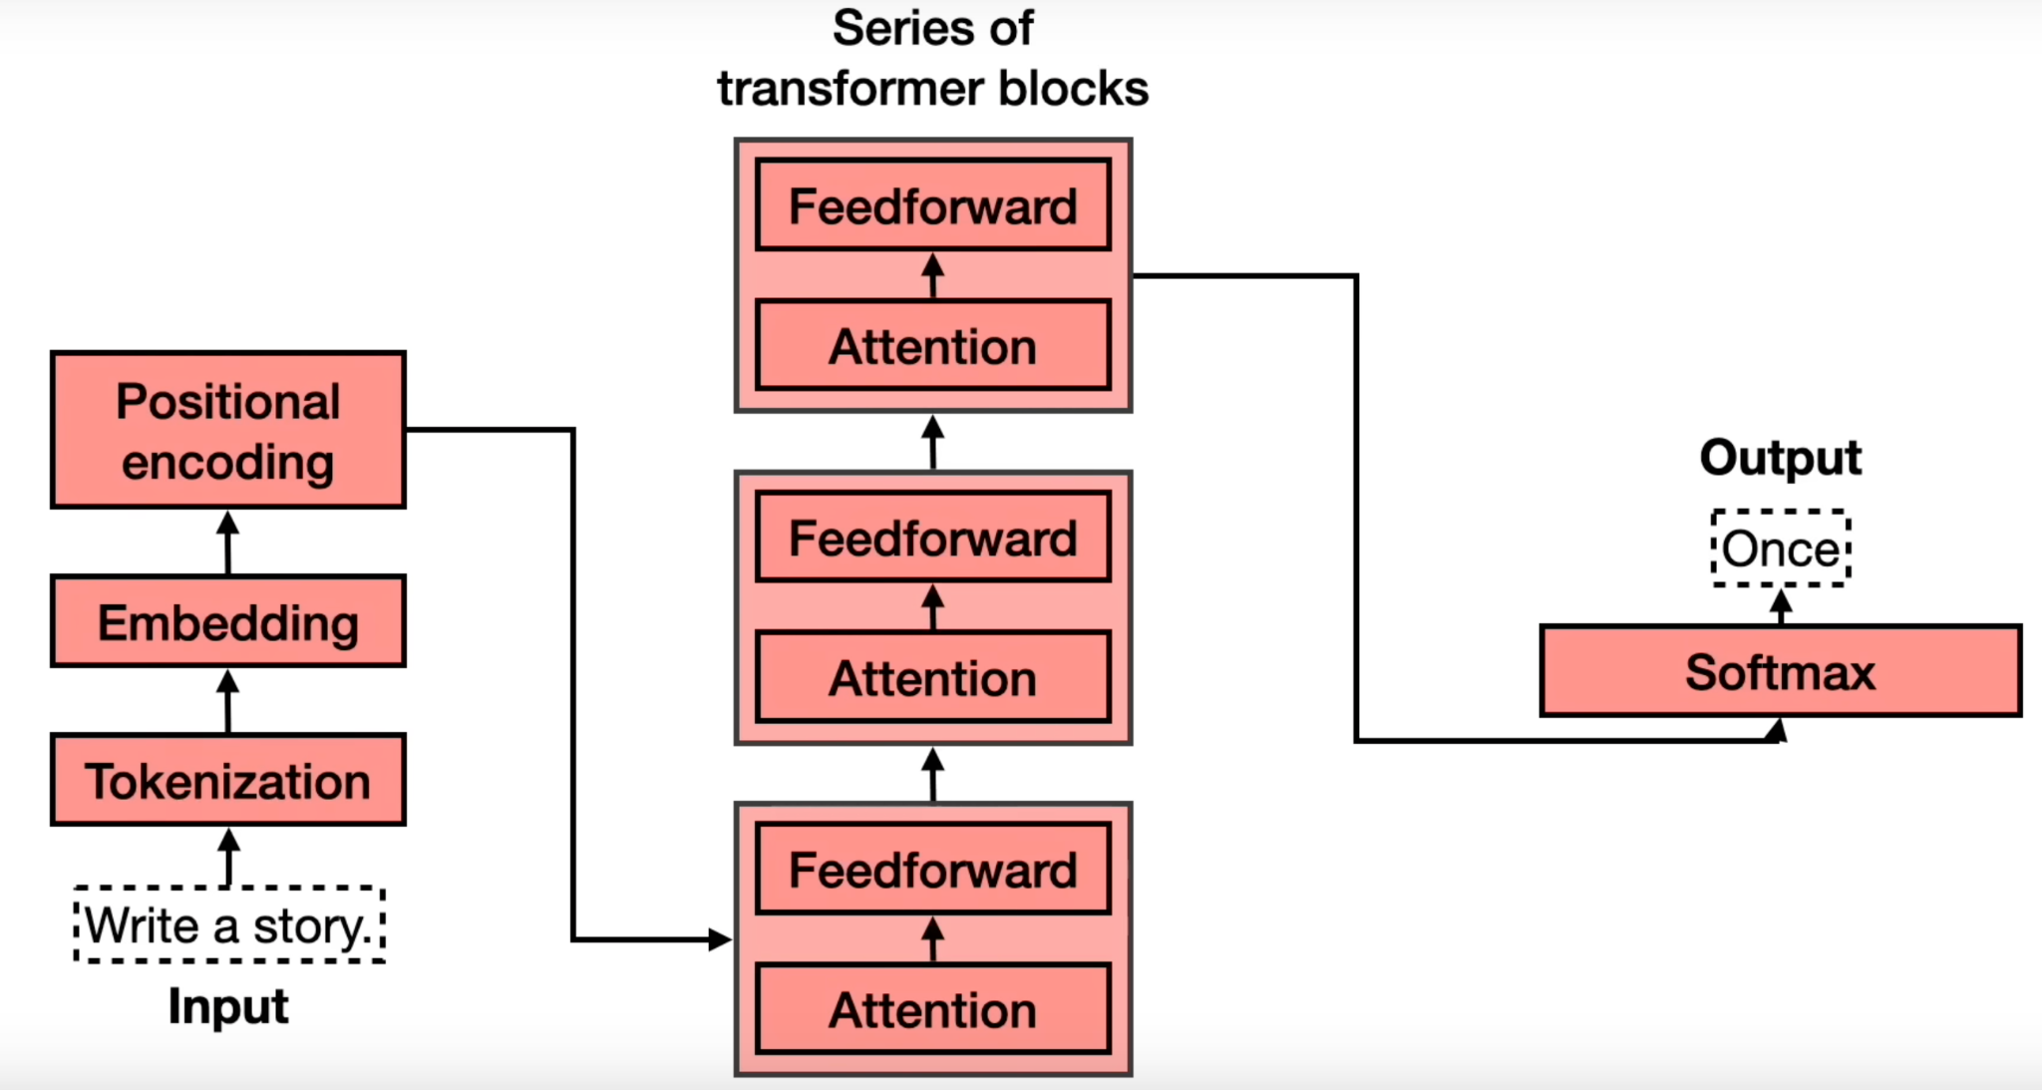
2. Tech Foundations of GenAI: Transformer
Transformer - Generating one word at a time
Images: https://www.youtube.com/watch?v=qaWMOYf4ri8&t=2337s

Slide 44
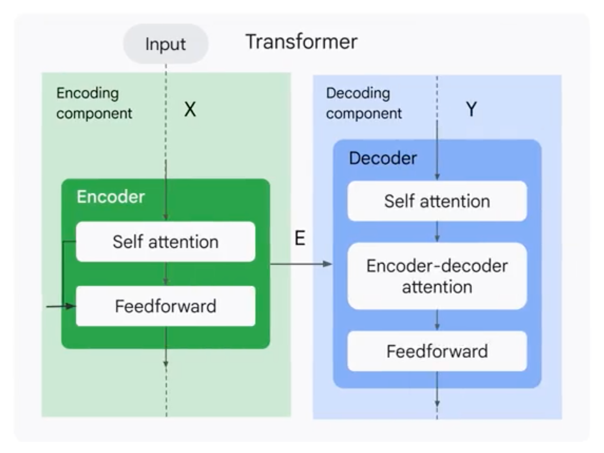
2. Tech Foundations of GenAI: Transformer
A transformer is a encoder-decoder model that uses the attention mechanism. It takes advantage of parallelisation and its built with Attention Mechanism at its core.
The Transformer models consist of encoder and decoder. The encoder encodes the input sequence and passes it to the decoder and the decoder decodes a representation for a relevant task.
Refer: https://www.coursera.org/learn/transformer-models-and-bert-modelb

Slide 45
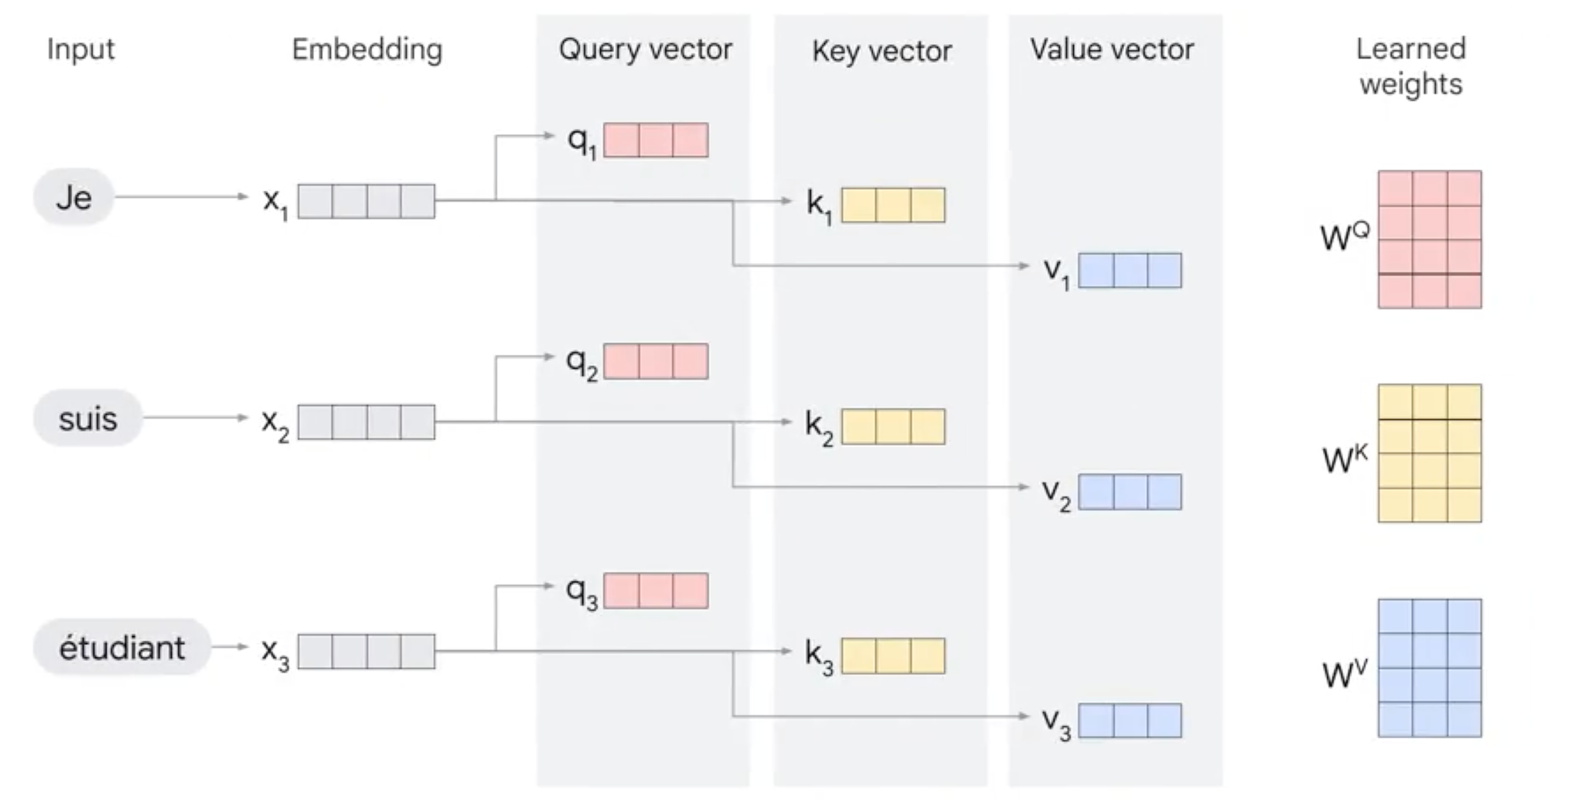
2. Tech Foundations of GenAI: Transformer
In the self attention layer, the input embedding is broken up into query, key and values vectors. These vectors are computed using weights that the transformer learns during the training process.
Refer: https://www.coursera.org/learn/transformer-models-and-bert-modelb

Slide 46
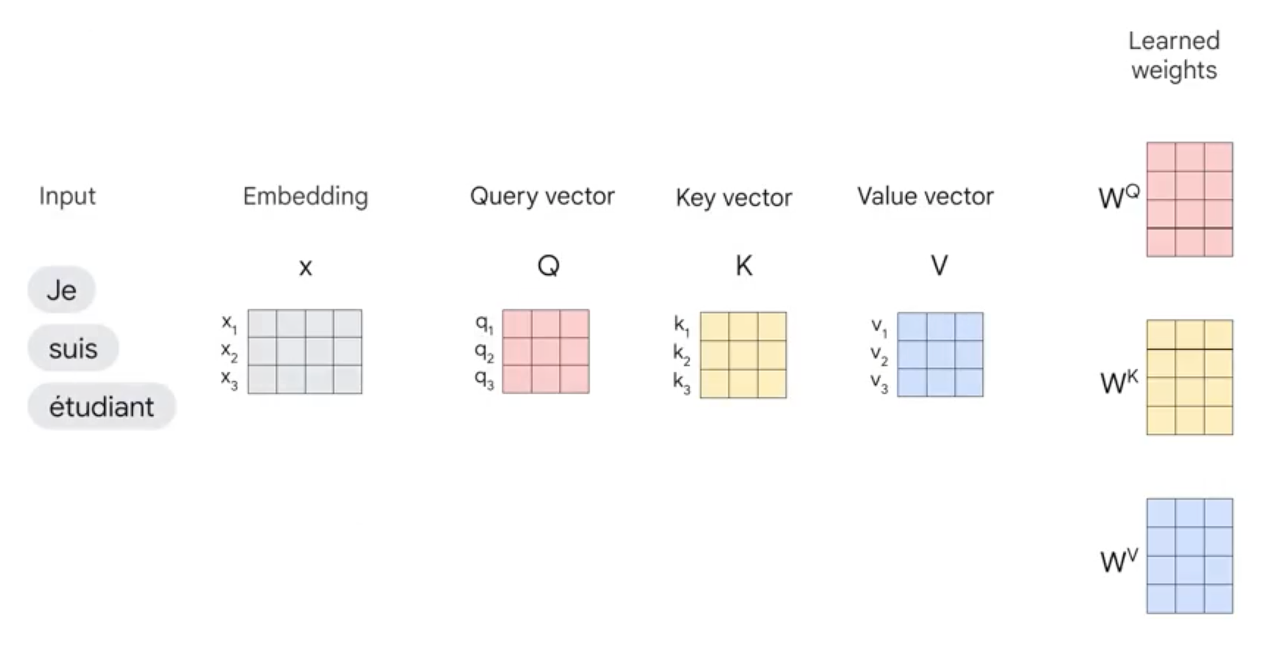
2. Tech Foundations of GenAI: Transformer
All of these computations happen in parallel in the model in the form of matrix computations
Refer: https://www.coursera.org/learn/transformer-models-and-bert-modelb

Slide 47
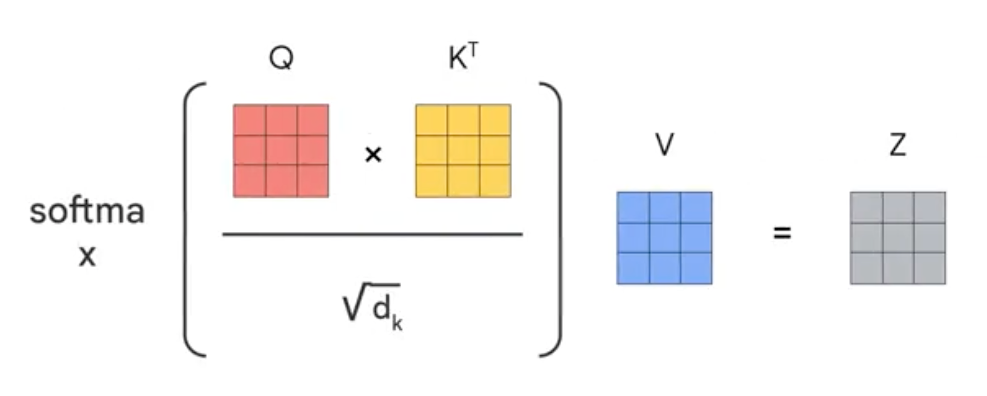
2. Tech Foundations of GenAI: Transformer
Once we have the query, key and value vectors, the next step is to multiply each value vector by by the softmax score in preparation to sum them up.
Refer: https://www.coursera.org/learn/transformer-models-and-bert-modelb

Slide 48
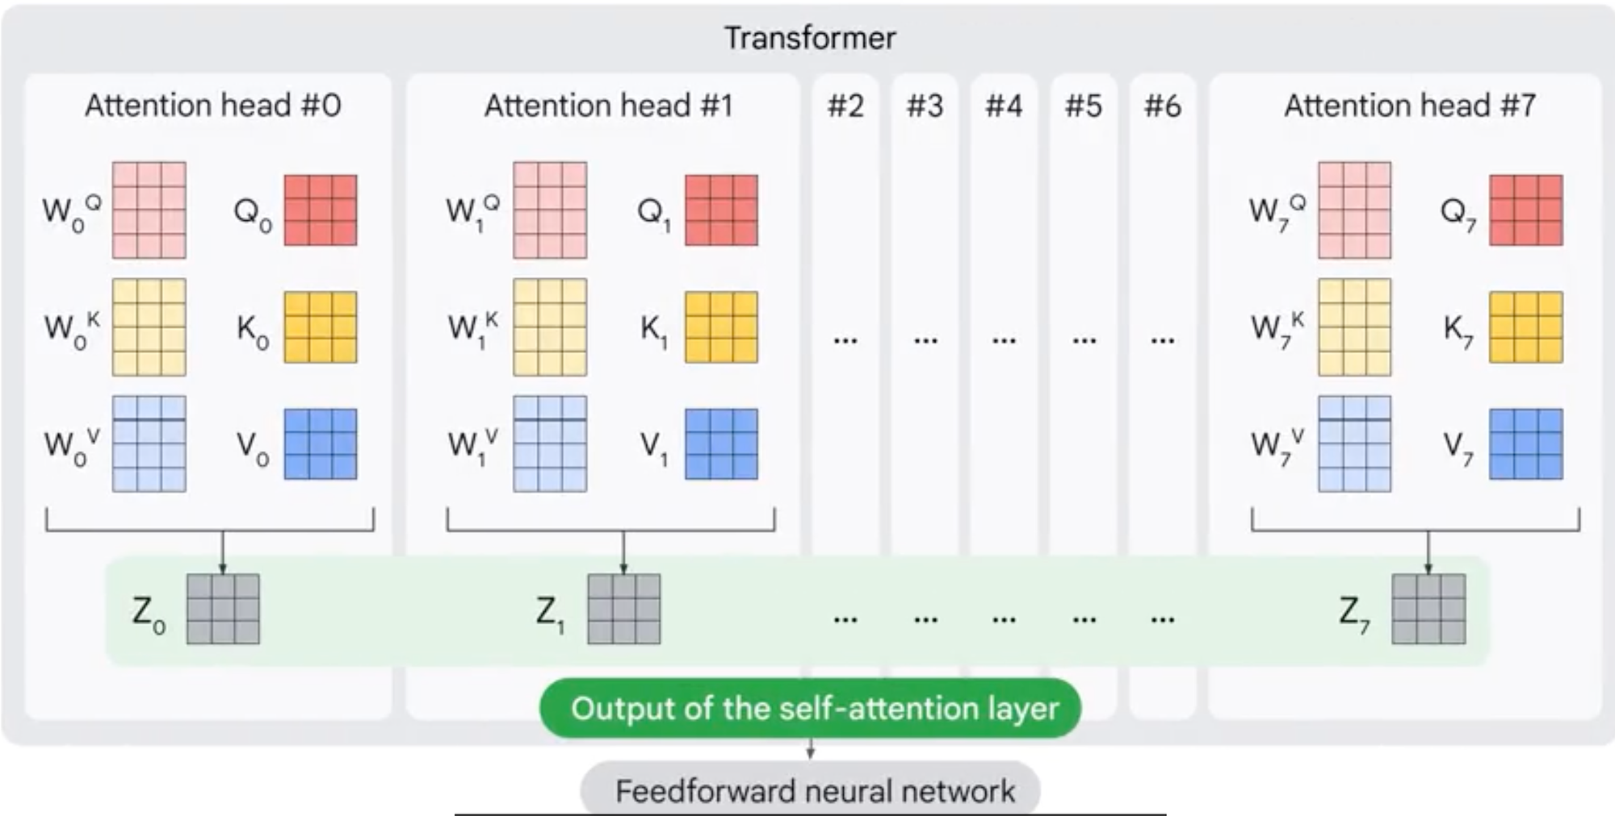
2. Tech Foundations of GenAI: Transformer
Next we have to sum the weighted value vectors, which produces the the output of self-attention layer at this position for the first word.
Refer: https://www.coursera.org/learn/transformer-models-and-bert-modelb

Slide 49
2. Tech Foundations of GenAI: Transformer
Next we have to sum the weighted value vectors, which produces the the output of self-attention layer at this position for the first word.
Refer: https://www.coursera.org/learn/transformer-models-and-bert-modelb

Slide 50
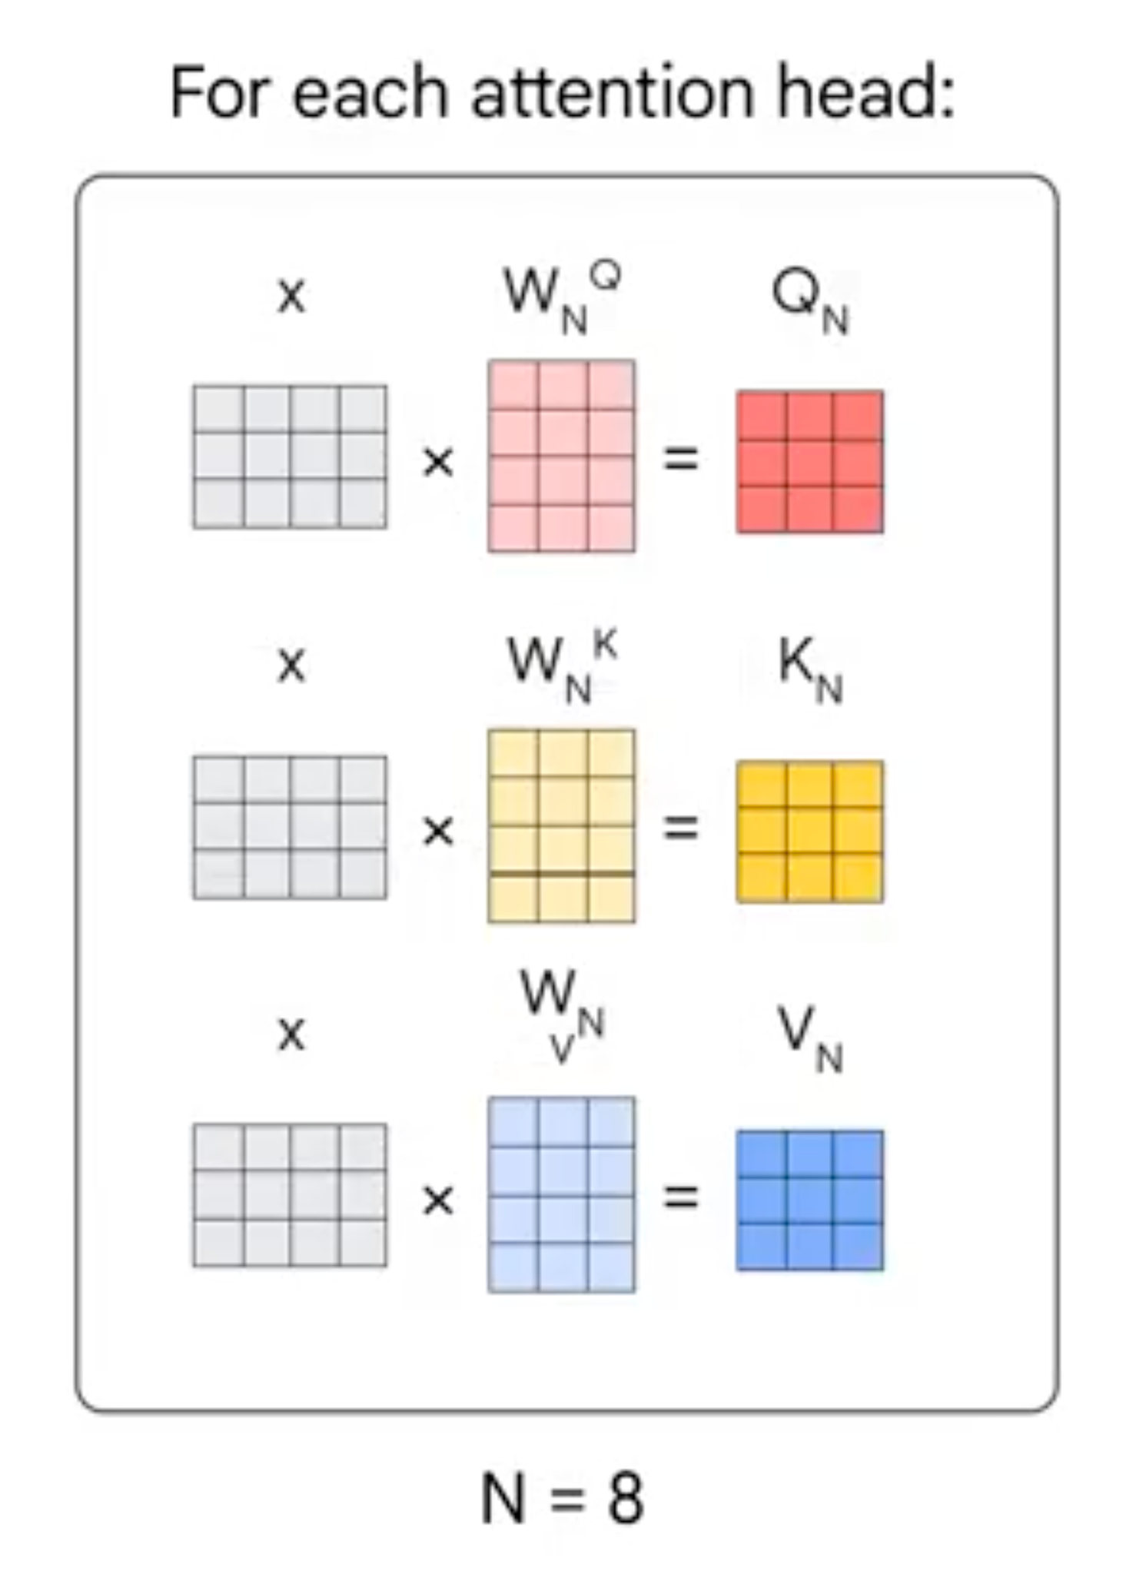
2. Tech Foundations of GenAI: Transformer
Perform multi headed attention (8 times in this case), and multiply the embedded words with respective weighted matrices.
Refer: https://www.coursera.org/learn/transformer-models-and-bert-modelb

Slide 51
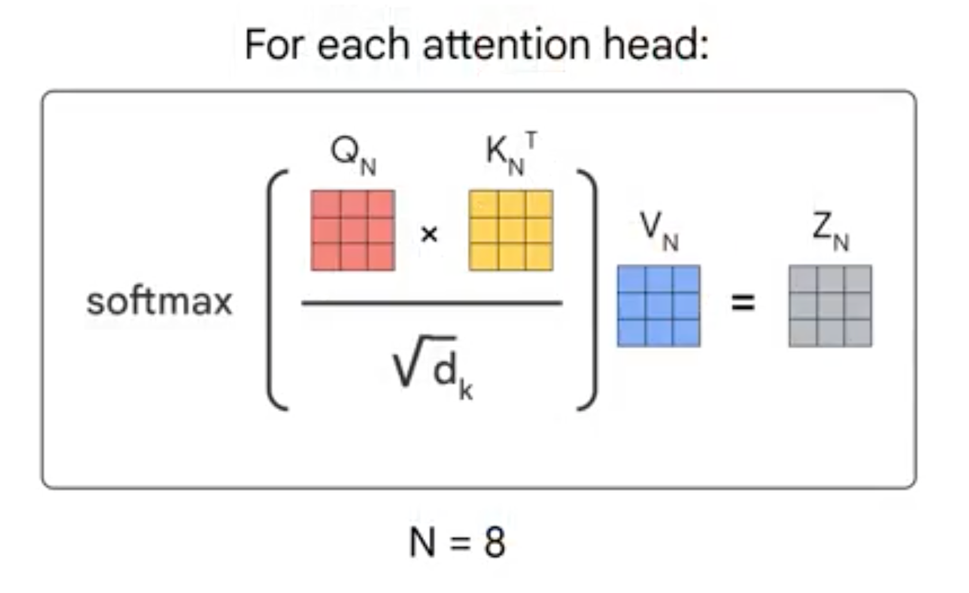
2. Tech Foundations of GenAI: Transformer
Calculate the attention using the resulting QKV matrices
Refer: https://www.coursera.org/learn/transformer-models-and-bert-modelb

Slide 52
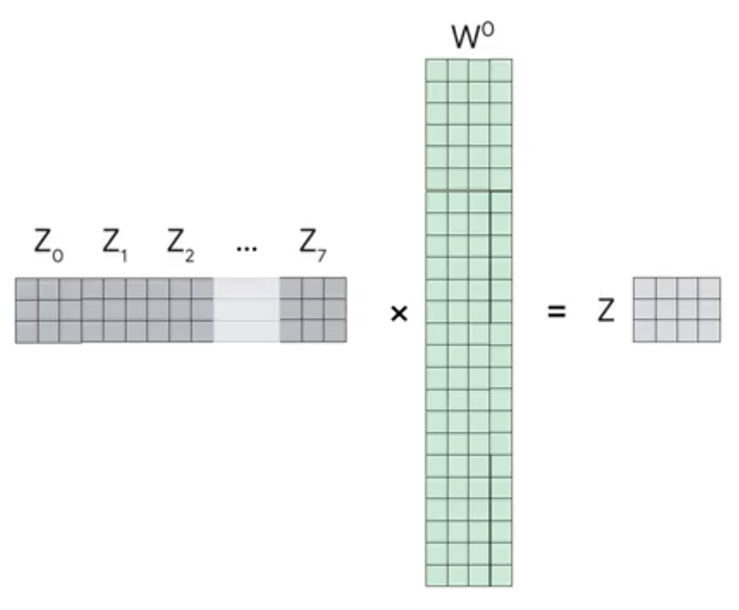
2. Tech Foundations of GenAI: Transformer
Concatenate the matrices to produce the output matrix which is the same dimension as the final matrix that this layer initially got.
Refer: https://www.coursera.org/learn/transformer-models-and-bert-modelb

Slide 53
2. Tech Foundations of GenAI: Transformer
There are multiple variations of transformers
Encoder-Decoder (BART)
Decoder only (GPT3, GPT4)
Encoder Only (BERT)
BERT (Bidirectional Encoder Representations from Transformer)
It is Encoder only model
It is one of the trained transformer models
It powers google search
Originally BERT was trained on two different tasks
Masked Language Modeling (MLM): Here the some percentage of input words are masked and the model is trained to predict the masked word
Next Sentence Prediction (NSP): Here BERT aims to Learn the relationships between sentences and predicts the next sentence given the first one.

Slide 54
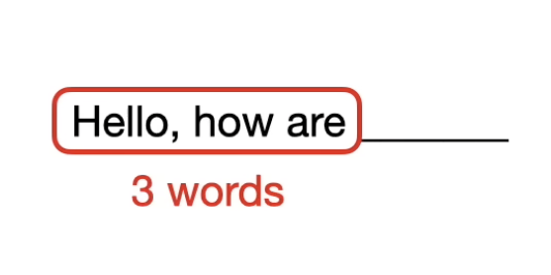
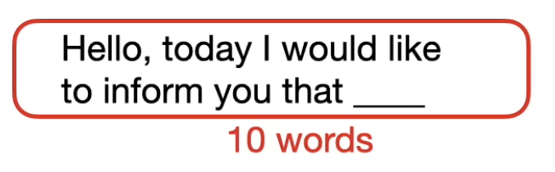
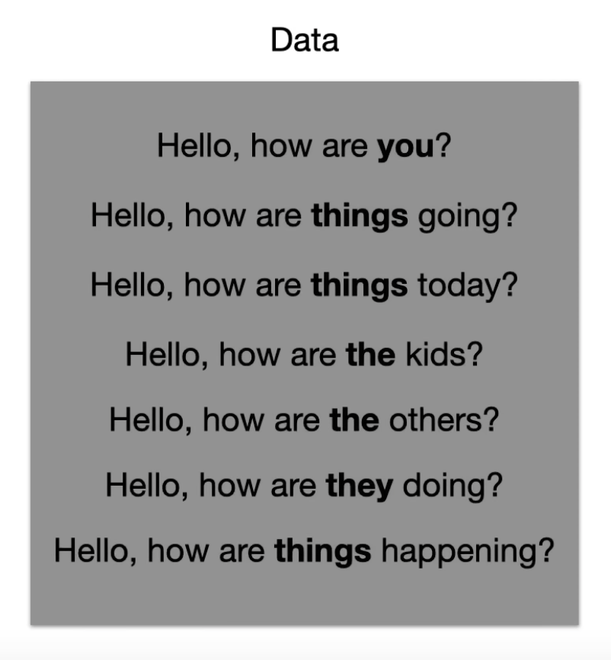
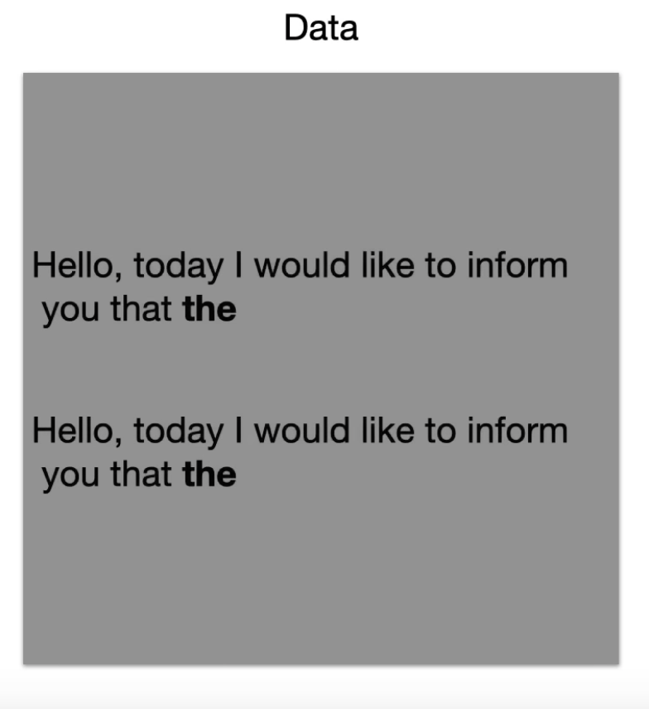
2. Tech Foundations of GenAI: n-grams
N-grams are contiguous sequences of N items (tokens) from a given text or sequence of data.
N-grams are used to capture the local context and syntactic structures of text data.

Slide 55
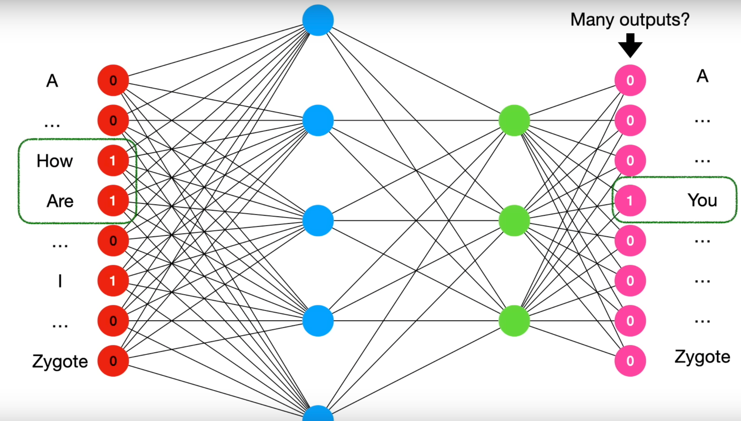
2. Tech Foundations of GenAI: Transformer
Images: https://www.youtube.com/watch?v=qaWMOYf4ri8&t=2337s

Slide 56
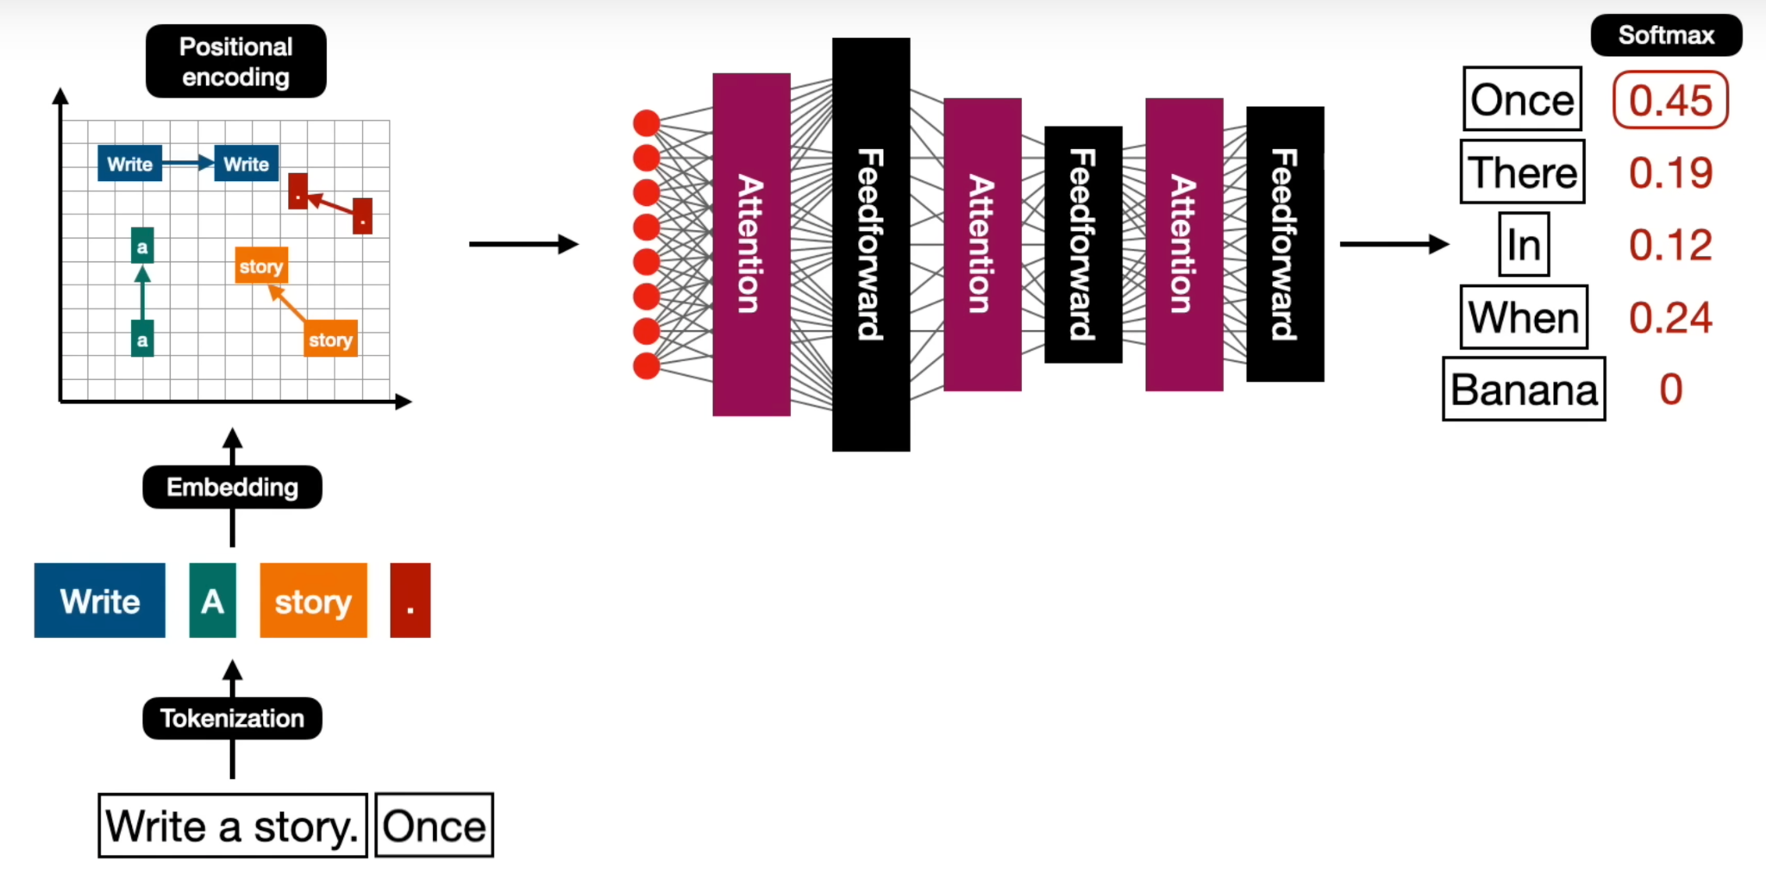
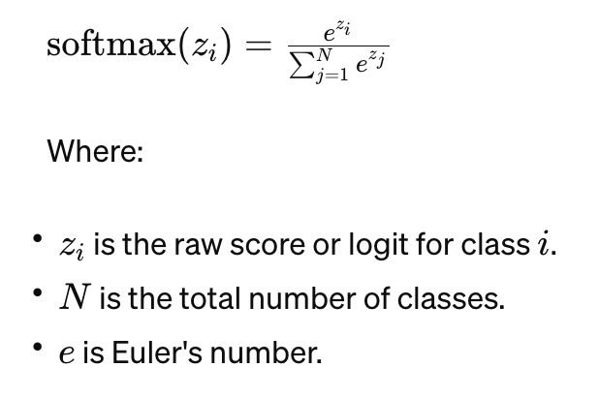
2. Tech Foundations of GenAI: Transformer
Images: https://www.youtube.com/watch?v=qaWMOYf4ri8&t=2337s

Slide 57
2. Tech Foundations of GenAI: Self Supervised Learning
Self-supervised learning involves training a model to predict certain aspects of the input text without relying on labeled data or explicit supervision
Types of self-supervised learning used for training large language models
Masked Language Modeling (MLM): Certain tokens in the input text are masked, and the model is trained to predict the masked tokens based on the surrounding context. The model learns representations of words and phrases that capture their semantic and syntactic relationships.
Next Sentence Prediction (NSP): Model is trained to predict whether a given pair of sentences are consecutive or not. The model learns the relationships between sentences enabling it to capture higher-level semantic information beyond just individual words and phrases.

Slide 58
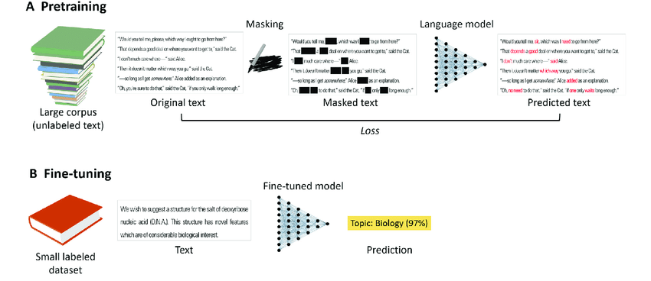
2. Tech Foundations of GenAI: Self Supervised Learning
Models can learn rich, general-purpose representations of language that can be fine-tuned for specific downstream tasks, such as text classification, question answering, or language generation.
Self-supervised learning used to train large language models like GPT and BERT (Bidirectional Encoder Representations from Transformers).

Slide 59
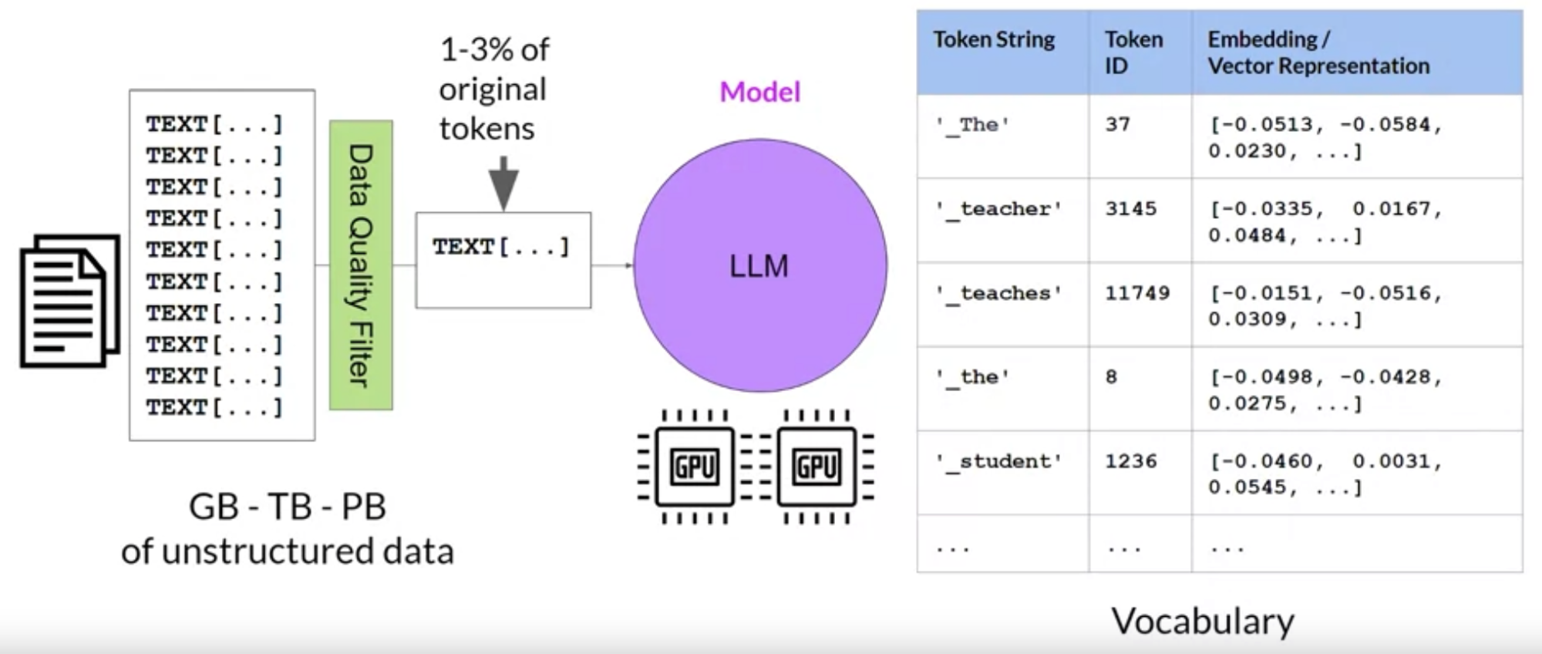
2. Tech Foundations of GenAI: Pre-Training
LLMs encode a deep statistical representation of language. This understanding is developed during the models pre-training phase when the model learns from vast amounts of unstructured textual data.
In this self-supervised learning step, the model internalizes the patterns and structures present in the language.
Refer: https://www.deeplearning.ai/courses/generative-ai-with-llms/

Slide 60
2. Tech Foundations of GenAI: Types of Transformer Model
There are three variance of the transformer model;
Encoder-only
Encoder-decoder models, and
Decode-only.
Encoder-only models also known as Autoencoding models, and they are pre-trained using masked language modeling. Here, tokens in the input sequence or randomly mask, and the training objective is to predict the mask tokens in order to reconstruct the original sentence. This is also called a denoising objective.
Autoencoding models have bi-directional representations of the input sequence, meaning that the model has an understanding of the full context of a token and not just of the words that come before.

Slide 61
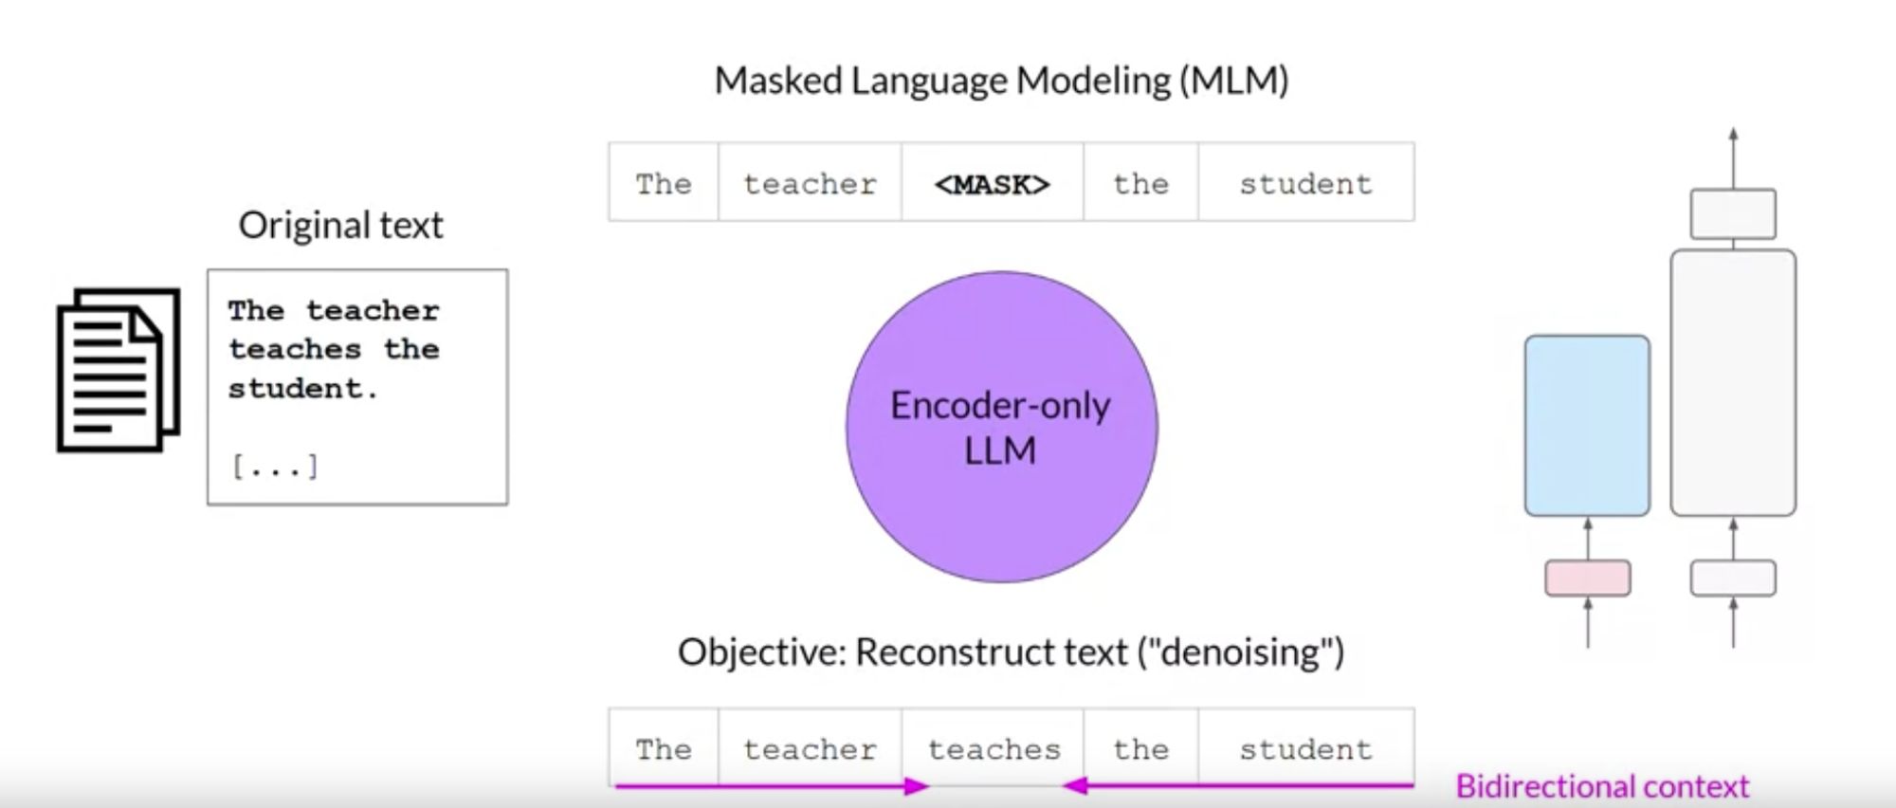
2. Tech Foundations of GenAI: Pre-Training
We can use them to carry out sentence classification tasks, for example, sentiment analysis.
E.g. BERT and RoBERTa
Refer: https://www.deeplearning.ai/courses/generative-ai-with-llms/

Slide 62
2. Tech Foundations of GenAI: Pre-Training
Decoder-only or autoregressive models, which are pre-trained using causal language modeling. Here, the training objective is to predict the next token based on the previous sequence of tokens.
Decoder-based autoregressive models, mask the input sequence and can only see the input tokens leading up to the token in question. The model has no knowledge of the end of the sentence.
The model iterates over the input sequence one by one to predict the following token, this means that the context is unidirectional.
Models of this type make use of the decoder component off the original architecture without the encoder. Decoder-only models are often used for text generation.
Well known examples of decoder-based autoregressive models are GPT and BLOOM.

Slide 63
2. Tech Foundations of GenAI: Pre-Training
Sequence-to-sequence model uses both the encoder and decoder parts off the original transformer architecture.
Model pre-trains the encoder using span corruption, i.e. masks random sequences of input tokens. Those mass sequences are then replaced with a unique Sentinel token (x).
Sentinel tokens are special tokens added to the vocabulary, but do not correspond to any actual word from the input text. The decoder is then tasked with reconstructing the mask token sequences auto-regressively.

Slide 64

2. Tech Foundations of GenAI: Pre-Training
Sequence-to-sequence models for translation, summarization, and question-answering.
A popular sequence-to-sequence model T5 BART.
Refer: https://www.deeplearning.ai/courses/generative-ai-with-llms/

Slide 65

2. Tech Foundations of GenAI: Pre-Training
Refer: https://www.deeplearning.ai/courses/generative-ai-with-llms/

Slide 66

2. Tech Foundations of GenAI: larger the model, the better?
Researchers have found that the larger a model, the more likely it is to work as you needed to without additional in-context learning or further training.
This steady increase in model size actually led some researchers to hypothesize the existence of a new Moore's law for LLMs.
Refer: https://www.deeplearning.ai/courses/generative-ai-with-llms/

Slide 67
3. Foundation Models (FMs) / Large Language Models (LLMs)
Foundation Models (FMs) or Large Language Models (LLMs) are a form of generative artificial intelligence (generative AI). They generate output from one or more inputs (prompts) in the form of human language instructions.
LLMs are large, complex, deep, neural network based models
LLMs are primarily based primarily built with a Decoder-only Transformers based Architecture.
LLMs are trained using Self-Supervised Learning and Semi-Supervised Learning techniques.
Note: LLMs typically do not directly utilize or rely on Generative Adversarial Networks (GANs) or Variational Autoencoders (VAEs) for their training or operation. Although researchers have explored integrating GANs or VAEs into LLM architectures to enhance their generative capabilities
Notes:
Foundation models encompass a broader range of architectures and techniques used in NLP, while LLMs represent a specific application or focus within this broader context. In other words, all LLMs are foundation models, but not all foundation models are LLMs. LLMs leverage the general language understanding learned by foundation models to excel at text generation tasks specifically.
-----------
Rather than develop artificial intelligence (AI) from scratch, data scientists use a foundation model as a starting point to develop ML models that power new applications more quickly and cost-effectively. The term foundation model was coined by researchers to describe ML models trained on a broad spectrum of generalized and unlabeled data and capable of performing a wide variety of general tasks such as understanding language, generating text and images, and conversing in natural language. The size and general-purpose nature of FMs make them different from traditional ML models, which typically perform specific tasks, like analyzing text for sentiment, classifying images, and forecasting trends. You can use foundation models as base models for developing more specialized downstream applications.
----------
----------
Broad Representation Learning: Foundation models are trained on diverse and extensive datasets, such as large text corpora, to learn general representations of language and context. This enables them to capture a wide range of linguistic patterns, semantic relationships, and domain knowledge.
Transfer Learning: Foundation models are designed to facilitate transfer learning, where knowledge learned from pre-training on a large dataset is transferred to downstream tasks with minimal task-specific data. This transfer learning paradigm allows for more efficient and effective training on specific tasks.
Scalability: Foundation models are typically large-scale neural network architectures with millions or even billions of parameters. These models require significant computational resources for training but can capture complex patterns and relationships in the input data.
----------
we’ve managed to build AI systems that can learn from thousands, or millions, of examples to help us better understand our world, or find new solutions to difficult problems. These large-scale models have led to systems that can understand when we talk or write, such as the natural-language processing and understanding programs we use every day, from digital assistants to speech-to-text programs. Other systems, trained on things like the entire work of famous artists, or every chemistry textbook in existence, have allowed us to build generative models that can create new works of art based on those styles, or new compound ideas based on the history of chemical research.
----------
For each new application, you need to ensure that there’s a large, well-labelled dataset for the specific task you want to tackle. If a dataset didn’t exist, you’d have to have people spend hundreds or thousands of hours finding and labelling appropriate images, text, or graphs for the dataset. Then the AI model has to learn to recognize everything in the dataset, and then it can be applied to the use case you have, from recognizing language to generating new molecules for drug discovery. And training one large natural-language processing model, for example, has roughly the same carbon footprint as running five cars over their lifetime.
----------
The next wave in AI looks to replace the task-specific models (mentioned above) that have dominated the AI landscape to date. The future is models that are trained (self supervised training) on a broad set of unlabeled data that can be used for different tasks, with minimal fine-tuning. These are called foundation models, a term first popularized by the Stanford Institute for Human-Centered Artificial Intelligence. Early examples of models, like GPT-3, BERT, or DALL-E 2, have shown what’s possible. Input a short prompt, and the system generates an entire essay, or a complex image, based on your parameters, even if it wasn’t specifically trained on how to execute that exact argument or generate an image in that way.
----------
What makes these new systems foundation models is that they, as the name suggests, can be the foundation for many applications of the AI model. Using self-supervised learning and transfer learning, the model can apply information it’s learnt about one situation to another. While the amount of data is considerably more than the average person needs to transfer understanding from one task to another, the end result is relatively similar: You learn to drive on one car, for example, and without too much effort, you can drive most other cars — or even a truck or a bus.
----------
With a pre-trained foundation model, we can reduce labeled data requirements dramatically. First, we could fine-tune it domain-specific unlabeled corpus to create a domain-specific foundation model. Then, using a much smaller amount of labeled data, potentially just a thousand labeled examples, we can train a model for summarization. The domain-specific foundation model can be used for many tasks as opposed to the previous technologies that required building models from scratch in each use case.
----------
Some recent implementations are based on other architectures, such as recurrent neural network variants and Mamba (a state space model)

Slide 68
3. Foundation Models (FMs) / Large Language Models (LLMs)
Foundation Models
Large scale deep neural networks models (with millions or even billions of parameters) trained on vast amounts of diverse data (such as large text corpora) to learn general representations of the input data domain.
Train a single general purpose large model instead of many smaller task specific models.
Self-Supervised Learning to learn inherent structure or relationships within the input data itself, without requiring explicit supervision or labeled data
Enables Transfer Learning - knowledge learned from pre-training on a large dataset is transferred to downstream tasks with minimal task-specific data.
Pre-trained foundation models as a starting point and then fine-tune them on task-specific data to adapt them to particular tasks.

Slide 69
3. Foundation Models (FMs) / Large Language Models (LLMs)
Examples of Foundation Models - All based on Transformer Architecture
Google’s BERT (Bidirectional Encoder Representations from Transformers) - Released in 2018, it was trained using 340 million parameters and a 16 GB training dataset.
Google’s T5 (Text-To-Text Transfer Transformer) - Released in 2019, it had 11 billion parameters and was trained on a large Common Crawl dataset.
OpenAI’s GPT-4 (Generative Pre-trained Transformer) - Released in 2023, it was trained using 170 trillion parameters and a 45 GB training dataset.
FMs, such Anthropic’s Claude 2 and Meta’s Llama 2, Mistral and the text-to-image model like Stability AI’s Stable Diffusion can perform a range of tasks, like writing blog posts, generating images, solving math problems, engaging in dialog, and answering questions etc.
Notes:
BERT is an "encoder-only" transformer architecture.
On a high level, BERT consists of three modules:
embedding. This module converts an array of one-hot encoded tokens into an array of vectors representing the tokens.
a stack of encoders. These encoders are the Transformer encoders. They perform transformations over the array of representation vectors.
un-embedding. This module converts the final representation vectors into one-hot encoded tokens again.
The un-embedding module is necessary for pretraining, but it is often unnecessary for downstream tasks. Instead, one would take the representation vectors output at the end of the stack of encoders, and use those as a vector representation of the text input, and train a smaller model on top of that.
BERT uses WordPiece to convert each English word into an integer code. Its vocabulary has size 30,000. Any token not appearing in its vocabulary is replaced by [UNK] for "unknown".
----------

Slide 70
3. Foundation Models (FMs) / Large Language Models (LLMs)
Potential use of FMs include automating tasks and processes. For example
Customer support
Language translation
Content generation
High-resolution image generation
Robotics and many more
It’s faster and cheaper for data scientists to use pre-trained FMs to develop new ML applications rather than train unique ML models from the ground up.
FM for Humanoids

Slide 71
4. Prompt Engineering
Prompt engineering is a technique used to design and refine the prompts or conditioning text provided to large language models.
Prompt engineering is particularly relevant in settings where fine-tuning or adapting pre-trained language models for specific tasks is not feasible or practical.
Effective prompts are carefully crafted to provide the necessary context and constraints to guide the model towards generating relevant and accurate responses.
Iterative refinement helps improve the quality and performance of the model by fine-tuning the prompts based on empirical observations and feedback.

Slide 72

5. Fine Tuning
Fine tuning is performed on a custom/domain/task specific dataset.
Fine tuning is a process of taking a general purpose LLM model and converting it to a specialised ones. For ex: Instruction fine tuning is one of the variants of fine tuning that made GPT3 into ChatGPT.

Slide 73
5. Fine Tuning
Fine tuning is one of the three ways to tune the LLM to behave and perform on a specific task on hand. The other ways are “Prompt Engineering” and “Retrieval Augmentation Generation”
Fine tuning comes after pre training process. While pre training is a Un/Semi/Self supervised training on large, unlabelled and general purpose corpus, fine tuning is usually a supervised training on a small, labelled task specific dataset.
Fine Tuning steps: Selecting a pre-trained model → Gathering and pre processing Relevant Dataset → Fine Tuning
Fine-tuning LLMs is commonly used in NLP tasks such as sentiment analysis, named entity recognition, summarization, translation etc. where understanding context and generating coherent language is crucial.

Slide 74
5. Fine Tuning
Two types of Fine tuning
Full Fine tuning (Instruction Fine Tuning): Is a type that updates all model weights, creating a new version with improved capabilities. It requires sufficient memory and computational resources, similar to pre-training, to handle the storage and processing of gradients, optimizers, and other components during training.
Partial Fine Tuning (PEFT: LoRA, QLoRA): Is a form of fine-tuning that only updates only a subset of parameters, effectively “freezing” the rest. This reduces the number of trainable parameters, making memory requirements more manageable and preventing catastrophic forgetting. PEFT maintains the original LLM weights, avoiding the loss of previously learned information.
Note: Memory allocation is not only required for storing the model but also for essential parameters during training, presenting a challenge for simple hardware.

Slide 75

5. Fine Tuning
In contrast to pre-training, where you train the LLM using vast amounts of unstructured textual data via self supervised learning, fine-tuning is a supervised learning process where you use a data set of labeled examples to update the weights of the LLM.
The labeled examples are prompt completion pairs, the fine-tuning process extends the training of the model to improve its ability to generate good completions for a specific task.
Refer: https://www.deeplearning.ai/courses/generative-ai-with-llms/

Slide 76

5. Fine Tuning - Instruction fine tuning
Instruction fine-tuning trains the model using examples that demonstrate how it should respond to a specific instruction.
Instruction fine-tuning, where all of the model's weights are updated is known as full fine-tuning.
Refer: https://www.deeplearning.ai/courses/generative-ai-with-llms/

Slide 77

5. Fine Tuning
To fine tune the model to improve its summarization ability, you'd build up a data set of examples that begin with the instruction summarize, the following text or a similar phrase.
And if you are improving the model's translation skills, your examples would include instructions like translate this sentence.
Refer: https://www.deeplearning.ai/courses/generative-ai-with-llms/

Slide 78

5. Fine Tuning: What does it do?
It lets us put more data than what fits into the prompt.
It gets the model to learn the data instead of getting an access to it
It steers the model to produce more consistent output
It reduces hallucinations
It customises the model to more specific use case
It process is similar to models pre-training.
Refer: https://www.coursera.org/projects/finetuning-large-language-models-project

Slide 79
5. Fine Tuning: Compared to Prompt Engineering
Prompt Engineering
Pros:
Nearly unlimited data fits
Learn new information
Correct incorrect information
Can use RAG too
Cons:
More high quality data
Upfront compute cost
Need knowledge to process data and fine tuning
Fine-tuning
Pros:
No data to get started
Small upfront cost
No technical knowledge
Connect data through Retrieval (RAG)
Cons:
Fits relatively less data
Forgets data
Hallucinate

Slide 80
5. Fine Tuning: Benefits
While Prompting is good for generic side projects and prototype, Fine-tuning is preferred for domain-specific, enterprise, production usage, privacy etc.
Demonstrates better performance in terms of reduced hallucinations and increased consistency.
By fine-tuning a pre-trained model on a specific task, we can adapt and refine its learned representations to better suit the characteristics of the target task or domain.
Fine-tuning typically requires less training time and data compared to training a model from scratch.
We can fine-tune different layers or parts of the pre-trained model depending on the task requirements and the amount of available training data.

Slide 81
5. Fine Tuning
PEFT
Technique used to fine-tune large pre-trained language models in a computationally efficient manner. It aims to achieve good performance on downstream tasks while reducing the computational cost and resource requirements associated with fine-tuning large models.
PEFT often involves making architectural modifications to the pre-trained model to reduce its computational complexity while preserving its representational capacity.
For example, the model may be pruned, quantized, or compressed to reduce the number of parameters or the size of the model.

Slide 82
5. Fine Tuning
LoRA
Instead of fine-tuning all the weights that constitute the weight matrix of the pre-trained large language model, two smaller matrices that approximate this larger matrix are fine-tuned.
These matrices constitute the LoRA adapter. This fine-tuned adapter is then loaded into the pre-trained model and used for inference.
LoRA fine-tuning for a specific task or use case yields an unchanged original LLM and a considerably smaller “LoRA adapter,” often representing a single-digit percentage of the original LLM size (in MBs rather than GBs).
During inference, the LoRA adapter is combined with its original LLM. The advantage is that the LoRA adapters reuses the original LLM, reducing overall memory reqt.

Slide 83
5. Fine Tuning
QLoRA
QLoRA represents a more memory-efficient iteration of LoRA. QLoRA quantizing the weights of the LoRA adapters (smaller matrices) to lower precision (e.g., 4-bit instead of 8-bit) making LoRA more memory efficient i.e. reduces memory footprint and storage requirements
Despite this reduction in bit precision, QLoRA maintains a comparable level of effectiveness to LoRA.

Slide 84

5. Fine Tuning: Traditional / Full Fine-tuning
Here we modify a pre-trained neural networks weights to adapt to a new task. This adjustment involves altering the original weight matrix ( W ) of the network. The changes made to ( W ) during fine-tuning are collective ly represented by ( Δ W ), such that the updated weights can be expressed as ( W + Δ W ).
Refer: https://towardsdatascience.com/understanding-lora-low-rank-adaptation-for-finetuning-large-models-936bce1a07c6

Slide 85
5. Fine Tuning: Low Rank Adaptation
Here, rather than modifying ( W ) directly, the LoRA approach seeks to decompose (ΔW); rank hypothesis suggests that significant changes to the neural network can be captured using a lower-dimensional representation.
LoRA proposes representing ( Δ W ) as the product of two smaller matrices, ( A ) and ( B ), with a lower rank. The updated weight matrix ( W’ ) thus becomes:
[ W’ = W + BA ]
In this equation, ( W ) remains frozen (i.e., it is not updated during training). The matrices ( B ) and ( A ) are of lower dimensionality, with their product ( BA ) representing a low-rank approximation of ( Δ W ).
Refer: https://towardsdatascience.com/understanding-lora-low-rank-adaptation-for-finetuning-large-models-936bce1a07c6
Notes:
Dimensionality reduction: Techniques like Principal Component Analysis (PCA) and Singular Value Decomposition (SVD) exploit the low-rank structure of matrices to reduce the dimensionality of data while preserving important information.

Slide 86

5. Fine Tuning
The rank of a matrix refers to the number of linearly independent rows or columns in the matrix.
The reduced dimensionality of low-rank matrices allows for more compact representations and efficient storage and computation.
By choosing matrices ( A ) and ( B ) to have a lower rank ( r ), the number of trainable parameters is significantly reduced.
Low-Rank Adaptation (LoRA) method benefits
Reduced Memory Footprint
Faster Training and Adaptation
Feasibility for Smaller Hardware:
Scaling to Larger Models
Refer: https://towardsdatascience.com/understanding-lora-low-rank-adaptation-for-finetuning-large-models-936bce1a07c6

Slide 87
6. Retrieval Augmentation Generation (RAG)
Combines elements of both retrieval-based and generation-based approaches to produce high-quality and contextually relevant text responses.
In a retrieval-based approach, the system retrieves pre-existing responses or snippets of text from a large database (such as a knowledge base or a corpus of text) in response to user queries.
In a generation-based approach, the system generates responses from scratch based on the input query or context.
The system first retrieves a set of candidate passages or documents from a large corpus of text using a retrieval mechanism.Next, it generates a response by leveraging both the retrieved passages and the input query or context.
RAG + Fine-tuning

Slide 88

6. Retrieval Augmentation Generation (RAG)
Images: https://gradientflow.substack.com/p/best-practices-in-retrieval-augmented

Slide 89

7. Life Cycle of a Generative AI Project
Refer: Generative AI with LLMs Course by DeepLearning.AI: https://www.deeplearning.ai/courses/generative-ai-with-llms/

Slide 90
8. Recent Developments
1-bit LLM
RAFT
GROOT

Slide 91

The Era of 1-bit LLMs
Refer: "The Era of 1-bit LLMs: All Large Language Models are in 1.58 Bits".
Weight are represented as a trit - 1.58 bits {-1; 0; 1}, without losing performance of a Full Precision Transformer LLM with the same model size and training tokens.
Instead of multiplying, we just add (since multiplying by 1, 0, or -1 is just a plus, minus, or nothing).
This makes them 2.7x faster, use 3.5x less GPU memory, and 71x less energy.
Refer: https://arxiv.org/abs/2402.17764
Notes:
FP16 (Half Precision) and BF16 (Bfloat16) are two different floating-point formats used for representing numerical values in computing. While they have similarities, they also have distinct characteristics and use cases. Let's compare them:
Precision:
FP16: Half precision floating-point format, with 16 bits total (1 sign bit, 5 exponent bits, and 10 fraction bits).
BF16: Bfloat16 format, with 16 bits total (1 sign bit, 8 exponent bits, and 7 fraction bits).
Exponent Range:
FP16: Exponent range of approximately ±16.
BF16: Exponent range of approximately ±64.
Fraction Bits:
FP16: 10 fraction bits, providing fewer bits for representing the fractional part of the number.
BF16: 7 fraction bits, providing more bits for representing the fractional part of the number.
Range and Precision:
FP16: Offers less precision compared to single precision (32-bit) floating point format (FP32). It's suitable for tasks where memory/storage is a concern and sacrificing some precision is acceptable, such as deep learning inference on GPUs.
BF16: Offers higher precision compared to FP16 while still being more memory-efficient than single precision (32-bit) floating point format (FP32). It's particularly useful in machine learning applications, especially deep learning training, where it provides better numerical stability and accuracy compared to FP16.
Support and Hardware Implementation:
FP16: Widely supported in modern GPUs and some specialized hardware accelerators for deep learning.
BF16: Gaining popularity in deep learning frameworks and hardware due to its improved numerical stability and compatibility with existing hardware infrastructure.
Use Cases:
FP16: Often used in deep learning inference on GPUs, where memory and bandwidth constraints make it preferable over higher precision formats.
BF16: Increasingly used in deep learning training and inference, especially in scenarios where better numerical stability and accuracy are required compared to FP16.
In summary, while both FP16 and BF16 are 16-bit floating-point formats, they have differences in precision, exponent range, and use cases. FP16 is more commonly used in deep learning inference on GPUs due to its memory efficiency, while BF16 is gaining traction in deep learning training and inference for its improved numerical stability and accuracy.

Slide 92
RAFT: Retrieval Augmented Fine Tuning
Refer: RAFT: Adapting Language Model to Domain Specific RAG
Fine-tuning is akin to a "closed-book exam," where the model relies solely on the knowledge acquired during training to answer queries. Can lead to approximation and hallucination
RAG is like an "open-book exam," where the model retrieves relevant documents to generate answers. May retrieve "distractor" documents that are semantically similar but not relevant.
RAG involves storing those documents in a vector database and (at query time) finding documents based on their semantic similarity with the question and bringing them (including distrator docs) into the context of the LLM for in context learning.
RAFT given a question, and a set of retrieved documents, we train the model to ignore those documents that don't help in answering the question, which we call, distractor documents.
RAFT's chain-of-thought-style response helps improve the model's ability to reason apart from citing the right sequence from the relevant document that would help answer the question.
Notes:
Note the “distractor” documents may also be pulled into the model’s context even when they are not good sources for a well-reasoned answer.

Slide 93

RAFT: Retrieval Augmented Fine Tuning
Retrieval-Augmented Fine-Tuning” combines the benefits of Retrieval Augmented Generation and Fine-Tuning for better domain adaptation.
It allows the model to "study" the documents beforehand, process involving creating a synthetic dataset that includes questions, relevant and irrelevant documents, answers, and Chain-of-Thought explanations.
The it fine-tunes the model on this dataset, RAFT primes the LLM on domain knowledge and style while improving the quality of generated answers from the retrieved context.
Refer: https://arxiv.org/abs/2403.10131

Slide 94


GROOT: General-purpose Robot 00 Technology
Nvidia’s AI Model for Humanoid Robot Development.
GROOT powered robots will be designed to understand human language and emulate human gestures through imitation learning
Robots can interact with their environment, exhibit human-like behavior and perform complex tasks.
Employs Reinforcement Learning, echoing the essence of human learning through exploration and guided by feedback and rewards.
GR00T model takes multimodal instructions and past interactions as input and produces the actions for the robot to execute.
Refer: https://developer.nvidia.com/project-gr00t

Slide 95
Exit Test
Refer: Generative AI with LLMs Course by DeepLearning.AI: https://www.deeplearning.ai/courses/generative-ai-with-llms/

Slide 96
Question 1: Interacting with Large Language Models (LLMs) differs from traditional machine learning models. Working with LLMs involves natural language input, known as a _____, resulting in output from the Large Language Model, known as the ______ .
Choose the answer that correctly fill in the blanks.
Prompt, fine-tuned LLM
Prompt, completion
Prediction request, prediction response
Tunable request, completion
Refer: Generative AI with LLMs Course by DeepLearning.AI: https://www.deeplearning.ai/courses/generative-ai-with-llms/
Notes:
Answer B.
The input for working with LLMs is referred to as the prompt and the output from the LLM is referred to as the completion.

Slide 97
Question 2: Large Language Models (LLMs) are capable of performing multiple tasks supporting a variety of use cases. Which of the following tasks supports the use case of converting code comments into executable code?
Invoke actions from text
Text summarization
Information Retrieval
Translation
Refer: Generative AI with LLMs Course by DeepLearning.AI: https://www.deeplearning.ai/courses/generative-ai-with-llms/
Notes:
Answer: D

Slide 98
Question 3: What is the self-attention that powers the transformer architecture?
The ability of the transformer to analyze its own performance and make adjustments accordingly.
A technique used to improve the generalization capabilities of a model by training it on diverse datasets.
A mechanism that allows a model to focus on different parts of the input sequence during computation.
A measure of how well a model can understand and generate human-like language.
Refer: Generative AI with LLMs Course by DeepLearning.AI: https://www.deeplearning.ai/courses/generative-ai-with-llms/
Notes:
Answer: C
Self-attention is a key component in models like Transformers, where it enables the model to attend to different words in the input sequence to capture their relationships and dependencies.

Slide 99
Question 4: Which of the following stages are part of the generative AI model lifecycle? (Select all that apply)
Selecting a candidate model and potentially pre-training a custom model.
Deploying the model into the infrastructure and integrating it with the application.
Manipulating the model to align with specific project needs.
Performing regularization
Defining the problem and identifying relevant datasets.
Refer: Generative AI with LLMs Course by DeepLearning.AI: https://www.deeplearning.ai/courses/generative-ai-with-llms/
Notes:
Answer:
A: Selecting a candidate model and potentially pre-training a custom model are important stages in the generative AI model lifecycle.
B: Once we have a model performing to our needs, we can deploy it into the infrastructure and integrate it with the application.
C: It is likely we will have to manipulate the model in some way to align it with the specific needs of the project.
E: It is crucial to define the problem being solved and identify relevant datasets instrumental to the project.

Slide 100
Question 5: "RNNs are better than Transformers for generative AI Tasks." Is this true or false?
True
False
Refer: Generative AI with LLMs Course by DeepLearning.AI: https://www.deeplearning.ai/courses/generative-ai-with-llms/
Notes:
Answer:
False: While RNNs can be used for generative AI tasks, they struggle with compute and memory, making it hard to keep context in longer texts. The transformers architecture is more parallelizable and its dynamic attention mechanism helps to capture long-range dependencies in the input.

Slide 101
Question 6: Which transformer-based model architecture has the objective of guessing a masked token based on the previous sequence of tokens by building bidirectional representations of the input sequence.
Autoencoder
Autoregressive
Sequence-to-sequence
Refer: Generative AI with LLMs Course by DeepLearning.AI: https://www.deeplearning.ai/courses/generative-ai-with-llms/
Notes:
Answer: A
Autoencoder models are pre-trained using masked language modeling. They use randomly masked tokens in the input sequence and the pretraining objective is to predict the masked tokens to reconstruct the original sentence.

Slide 102
Question 7: Which transformer-based model architecture is well-suited to the task of text translation?
Autoencoder
Sequence-to-sequence
Autoregressive
Refer: Generative AI with LLMs Course by DeepLearning.AI: https://www.deeplearning.ai/courses/generative-ai-with-llms/
Notes:
Answer: B
Sequence-to-sequence models use both the encoder and decoders in the transformer-based architecture making them best suited for tasks such as translation, text summarization, and question answering.

Slide 103
Question 8: Scaling laws for pre-training large language models consider several aspects to maximize performance of a model within a set of constraints and available scaling choices. Select all alternatives that should be considered for scaling when performing model pre-training?
Compute budget: Compute constraints
Dataset size: Number of tokens
Batch size: Number of samples per iteration
Model size: Number of parameters
Refer: Generative AI with LLMs Course by DeepLearning.AI: https://www.deeplearning.ai/courses/generative-ai-with-llms/
Notes:
Answer:
A: The compute budget plays a crucial role in scaling during pre-training. When faced with a limited compute budget, we may need to impose restrictions on either the model size or the dataset size.
B: The size of the pre-training data is an important factor to consider when scaling with compute constraints. This is because the size of the dataset directly affects the computational requirements during pre-training, and having a larger dataset generally leads to improved model performance.
D: The size of the model in terms of number of parameters is a key scaling choice to consider with compute constraints because the number of parameters directly impacts the compute needs required during pre-training.

Slide 104
Question 9: Fill in the blanks: __________ involves using many prompt-completion examples as the labeled training dataset to continue training the model by updating its weights. This is different from _________ where you provide prompt-completion examples during inference.
In-context learning, Instruction fine-tuning
Prompt engineering, Pre-training
Pre-training, Instruction fine-tuning
Instruction fine-tuning, In-context learning
Refer: Generative AI with LLMs Course by DeepLearning.AI: https://www.deeplearning.ai/courses/generative-ai-with-llms/
Notes:
Answer: D

Slide 105
Question 10: Fine-tuning a model on a single task can improve model performance specifically on that task; however, it can also degrade the performance of other tasks as a side effect. This phenomenon is known as:
Catastrophic forgetting
Instruction bias
Catastrophic loss
Model toxicity
Refer: Generative AI with LLMs Course by DeepLearning.AI: https://www.deeplearning.ai/courses/generative-ai-with-llms/
Notes:
Answer: A

Slide 106
Question 11: Which evaluation metric below focuses on precision in matching generated output to the reference text and is used for text translation?
HELM
ROUGE-2
BLEU
ROUGE-1
Refer: Generative AI with LLMs Course by DeepLearning.AI: https://www.deeplearning.ai/courses/generative-ai-with-llms/
Notes:
Answer: C
BLEU focuses on precision and text translation while Rouge focuses on text summarization.
The evaluation metric that focuses on precision in matching the generated output to the reference text and is commonly used for text translation tasks is called "BLEU" (Bilingual Evaluation Understudy).
BLEU is a widely used metric for evaluating the quality of machine-translated text by comparing it to one or more reference translations. It measures the similarity between the generated translation and the reference translations based on n-gram overlap. BLEU focuses on precision by counting the number of n-grams (sequences of n words) in the generated translation that match n-grams in the reference translations.
While BLEU considers both precision and recall, it predominantly emphasizes precision because it penalizes the generated translation for including n-grams that do not appear in the reference translations. Therefore, higher BLEU scores indicate better precision in matching the generated output to the reference text.
Other evaluation metrics commonly used in text translation tasks include METEOR, TER (Translation Error Rate), and ROUGE (Recall-Oriented Understudy for Gisting Evaluation). However, among these, BLEU specifically emphasizes precision in matching the generated output to the reference text.

Slide 107
Question 12: Which of the following best describes how LoRA works?
LoRA trains a smaller, distilled version of the pre-trained LLM to reduce model size
LoRA freezes all weights in the original model layers and introduces new components which are trained on new data.
LoRA decomposes weights into two smaller rank matrices and trains those instead of the full model weights.
LoRA continues the original pre-training objective on new data to update the weights of the original model.
Refer: Generative AI with LLMs Course by DeepLearning.AI: https://www.deeplearning.ai/courses/generative-ai-with-llms/
Notes:
Answer: C
LoRA represents large weight matrices as two smaller, rank decomposition matrices, and trains those instead of the full weights. The product of these smaller matrices is then added to the original weights for inference.

Slide 108
Question 13: What is a soft prompt in the context of LLMs (Large Language Models)?
A set of trainable tokens that are added to a prompt and whose values are updated during additional training to improve performance on specific tasks.
A strict and explicit input text that serves as a starting point for the model's generation.
A technique to limit the creativity of the model and enforce specific output patterns.
A method to control the model's behavior by adjusting the learning rate during training.
Refer: Generative AI with LLMs Course by DeepLearning.AI: https://www.deeplearning.ai/courses/generative-ai-with-llms/
Notes:
Answer: A
A soft prompt refers to a set of trainable tokens that are added to a prompt. Unlike the tokens that represent language, these tokens can take on any value within the embedding space. The token values may not be interpretable by humans, but are located in the embedding space close to words related to the language prompt or task to be completed.

Slide 109
Question 14: "Prompt Tuning is a technique used to adjust all hyperparameters of a language model." Is this true or false?
True
False
Refer: Generative AI with LLMs Course by DeepLearning.AI: https://www.deeplearning.ai/courses/generative-ai-with-llms/
Notes:
Answer: False
Prompt Tuning focuses on optimizing the prompts given to the model using trainable tokens that don’t correspond directly to human language. The number of tokens you choose to train, however, would be a hyperparameter of your training process.

Slide 110
Question 15: "PEFT methods can reduce the memory needed for fine-tuning dramatically, sometimes to just 12-20% of the memory needed for full fine-tuning." Is this true or false?
True
False
Refer: Generative AI with LLMs Course by DeepLearning.AI: https://www.deeplearning.ai/courses/generative-ai-with-llms/
Notes:
Answer: True
By training a smaller number parameters, whether through selecting a subset of model layers to train, adding new, small components to the model architecture, or through the inclusion of soft prompts, the amount of memory needed for training is reduced compared to full fine-tuning.

Slide 111
Question 16: What is a transformer model?
A deep learning model that uses self-attention to learn relationships between different parts of a sequence.
A computer vision model that uses fully connected layers to learn relationships between different parts of an image.
A machine learning model that uses recurrent neural networks to learn relationships between different parts of a sequence.
A natural language processing model that uses convolutions to learn relationships between different parts of a sequence.
Refer: Generative AI with LLMs Course by DeepLearning.AI: https://www.deeplearning.ai/courses/generative-ai-with-llms/
Notes:
Answer: A

Slide 112
Question 17: What is the attention mechanism?
A way of identifying the topic of a sentence
A way of predicting the next word in a sentence
A way of determining the similarity between two sentences
A way of determining the importance of each word in a sentence for the translation of another sentence
Refer: Generative AI with LLMs Course by DeepLearning.AI: https://www.deeplearning.ai/courses/generative-ai-with-llms/
Notes:
Answer: D

Slide 113
Question 18: What are the encoder and decoder components of a transformer model?
The encoder ingests an input sequence and produces a sequence of images. The decoder takes in the images from the encoder and produces an output sequence.
The encoder ingests an input sequence and produces a sequence of tokens. The decoder takes in the tokens from the encoder and produces an output sequence.
The encoder ingests an input sequence and produces a sequence of hidden states. The decoder takes in the hidden states from the encoder and produces an output sequence.
The encoder ingests an input sequence and produces a single hidden state. The decoder takes in the hidden state from the encoder and produces an output sequence.
Refer: Generative AI with LLMs Course by DeepLearning.AI: https://www.deeplearning.ai/courses/generative-ai-with-llms/
Notes:
Answer: C

Slide 114
Question 19: What are the two sublayers of each encoder in a Transformer model?
Embedding and classification
Self-attention and feedforward
Recurrent and feedforward
Convolution and pooling
Refer: Generative AI with LLMs Course by DeepLearning.AI: https://www.deeplearning.ai/courses/generative-ai-with-llms/
Notes:
Answer: B

Slide 115
Question 20: What are the three different embeddings that are generated from an input sentence in a Transformer model?
Embedding, classification, and next sentence embeddings
Convolution, pooling, and recurrent embeddings
Token, segment, and position embeddings
Recurrent, feedforward, and attention embeddings
Refer: Generative AI with LLMs Course by DeepLearning.AI: https://www.deeplearning.ai/courses/generative-ai-with-llms/
Notes:
Answer: C

Slide 116
Exit Quiz Answers
Q1:
Answer B.
The input for working with LLMs is referred to as the prompt and the output from the LLM is referred to as the completion.
Q2:
Answer: D
Q3
Answer: C
Self-attention is a key component in models like Transformers, where it enables the model to attend to different words in the input sequence to capture their relationships and dependencies.
Q4:
Answer:
A: Selecting a candidate model and potentially pre-training a custom model are important stages in the generative AI model lifecycle.
B: Once we have a model performing to our needs, we can deploy it into the infrastructure and integrate it with the application.
C: It is likely we will have to manipulate the model in some way to align it with the specific needs of the project.
E: It is crucial to define the problem being solved and identify relevant datasets instrumental to the project.
Notes:
Answer: C

Slide 117
Exit Quiz Answers
Q5
Answer: False: While RNNs can be used for generative AI tasks, they struggle with compute and memory, making it hard to keep context in longer texts. The transformers architecture is more parallelizable and its dynamic attention mechanism helps to capture long-range dependencies in the input.
Q6
Answer: A
Autoencoder models are pre-trained using masked language modeling. They use randomly masked tokens in the input sequence and the pretraining objective is to predict the masked tokens to reconstruct the original sentence
Q7
Answer: B
Sequence-to-sequence models use both the encoder and decoders in the transformer-based architecture making them best suited for tasks such as translation, text summarization, and question answering.
Q8
Answer:
A: The compute budget plays a crucial role in scaling during pre-training. When faced with a limited compute budget, we may need to impose restrictions on either the model size or the dataset size.
B: The size of the pre-training data is an important factor to consider when scaling with compute constraints. This is because the size of the dataset directly affects the computational requirements during pre-training, and having a larger dataset generally leads to improved model performance.
D: The size of the model in terms of number of parameters is a key scaling choice to consider with compute constraints because the number of parameters directly impacts the compute needs required during pre-training.
Notes:
Answer: C

Slide 118
Exit Quiz Answers
Q9
Answer: D
Q10
Answer: A
Q11
Answer: C
BLEU focuses on precision and text translation while Rouge focuses on text summarization.
The evaluation metric that focuses on precision in matching the generated output to the reference text and is commonly used for text translation tasks is called "BLEU" (Bilingual Evaluation Understudy).
Q12
Answer: C
LoRA represents large weight matrices as two smaller, rank decomposition matrices, and trains those instead of the full weights. The product of these smaller matrices is then added to the original weights for inference.
Notes:
Answer: C

Slide 119
Exit Quiz Answers
Q13
Answer: A
A soft prompt refers to aa set of trainable tokens that are added to a prompt. Unlike the tokens that represent language, these tokens can take on any value within the embedding space. The token values may not be interpretable by humans, but are located in the embedding space close to words related to the language prompt or task to be completed.
Q14
Answer: False
Prompt Tuning focuses on optimizing the prompts given to the model using trainable tokens that don’t correspond directly to human language. The number of tokens you choose to train, however, would be a hyperparameter of your training process.
Q15
Answer: True
By training a smaller number parameters, whether through selecting a subset of model layers to train, adding new, small components to the model architecture, or through the inclusion of soft prompts, the amount of memory needed for training is reduced compared to full fine-tuning.
Notes:
Answer: C

Slide 120
Thank You!

